Slide 1
Introduction to Food Justice
Groundswell Center Farm Business Planning Class
January 2018

Slide 2
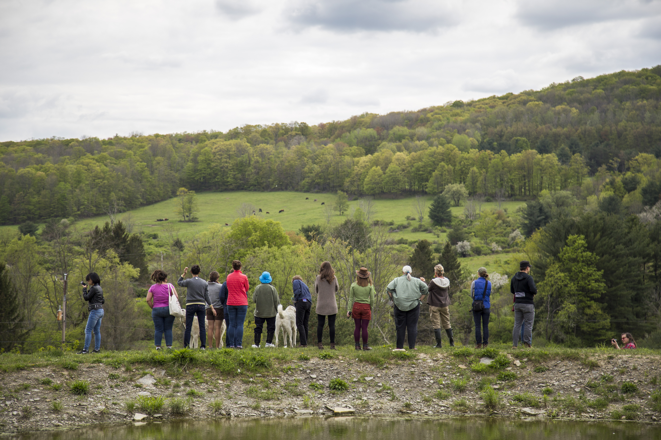
Food justice & equity outline
Week 1 [30 minutes]:
- Introduction to food systems and food justice
Week 5 [90 minutes]:
- History of Agricultural Injustice in the United States
- What is Systemic Oppression?
- Triple Bottom Line Business Examples
Week 8 [30 minutes]:
- Marketing for Social Justice
- Equity and your business

Slide 3
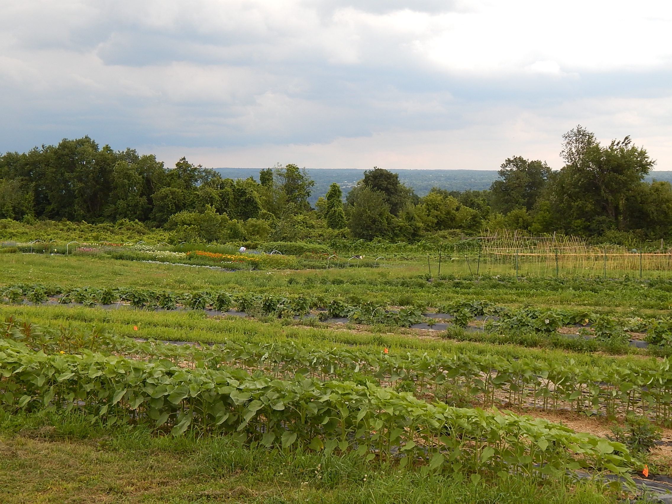
Groundswell mission
Groundswell engages diverse learners and empowers them with skills, knowledge and access to resources so they can build sustainable land-based livelihoods and equitable local food systems.

Slide 4
Corporate control of the global food system
Large farms with over $1 million in sales account for only 4 percent of all farms, but 66 percent of all sales in the U.S.1
Six corporations – Monsanto, DuPont, Dow, Syngenta, Bayer and BASF – control 75% of the world pesticides market.
Factory farms now account for 72 percent of poultry production, 43 percent of egg production, and 55 percent of pork production worldwide.
Only four corporations – ADM, Bunge, Cargill and Dreyfus – control more than 75% of the global grain trade. They overwhelmingly push commodity crops like corn and soy on local farmers at the expense of native crops.
Costs include pesticide toxicity, water pollution, soil depletion and erosion, loss of biodiversity, loss of mid-sized farms, and many more

Slide 5
Racism in the food system
Legacy of colonization: genocide and land theft from indigenous peoples
History of slavery: The enslaved labor of African people in the U.S. outcompeted agrarian wage labor for over 200 years (1619-1865)
In 1920, African-Americans owned 16 million acres of farmland. By 1997, less than 20,000 Black farmers owned just 2 million acres of land.
  The rate of Black land loss has been twice that of white land loss.
People of color tend to earn less than $10,000 in annual sales, produce only 3% of agricultural value, and farm just 2.8% of farm acreage.
In the U.S. people of color make $2.50 per hour less than white workers in the food chain
Of the 50 million food insecure people in the US 10.6% are white, 26.1% are Black, 23.7% are Latino and 23% are Native American

Slide 6
Classism in the food system
The industries of agriculture, food production, processing, distribution, retail and service sell over $1.8 trillion dollars in goods and services annually, accounting for an estimated 13 percent of U.S. GDP
One sixth of the U.S. workforce - close to 20 million people - work in the food system
Food workers face higher levels of food insecurity, or the inability to afford to eat, than the rest of the U.S. workforce. They therefore use food stamps at double the rate of the general U.S. workforce.
Of the 600+ food system workers surveyed by the Food Chain Workers Alliance in 2012, only 13.5% received a living wage.
The majority of food workers reported working in environments with health and safety violations, long work hours with few breaks, and lack of access to health benefits.

Slide 7
sexism in the food system
Despite the fact that women participate in the production and processing of food at roughly equal rates to men, most undernourished people in the world are women and girls.
Women’s earnings are lower than those of men in all sectors, but the agricultural wage gap is among the worst of any industry.
  US women farm operators as a whole receive 61 cents to the dollar made by men. Thus, when controlling for farm assets, work time, age, experience, farm type, and location, women generate nearly 40 percent less income than men.
30.3% of US female-headed households are food insecure, while only 22.4% of male-headed households are food insecure.

Slide 8
Food justice definitions
Food justice is communities exercising their right to grow, sell and eat healthy food. Healthy food is fresh, nutritious, affordable, culturally-appropriate, and grown locally with care for the well-being of the land, workers, and animals. [Justfood.org]
Food justice seeks to ensure that the benefits and risks of where, what, and how food is grown, produced, transported, distributed, accessed and eaten are shared fairly. [Robert Gottlieb and Anupama Joshi]
https://www.youtube.com/watch?v=StygQm6YlwQ

