Slide 1
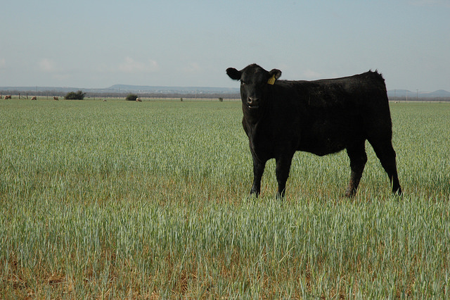
Leasing Agricultural Land
for Crops, Grazing, or Hunting
Tiffany Dowell Lashmet
Texas A&M AgriLife Extension
Shannon L. Ferrell
OSU Department of Agricultural Economics

Slide 2
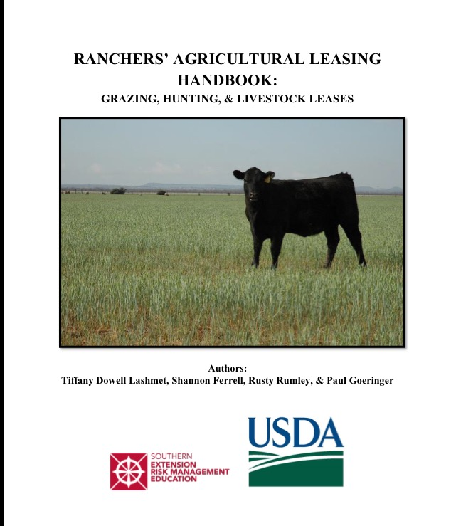
http://agrilife.org/texasaglaw/2016/07/05/ranchers-leasing-handbook/

Slide 3


Why lease land?
Landowners
Additional source of cash flow
  Gain liquidity from equity in owned land
  Build equity in mortgaged land
  Potentially important source of income for “farmers emeritus”
Can aid landowner in maintenance of land
Take advantage of alternative (agricultural use) valuation
Hunting leases – additional simultaneous use of land

Slide 4
Why lease land?
Operators
Beginning producers can access expertise of landowners
“Land’s expensive, man!”
  Does not require down payment
  Obtaining mortgage may be difficult (especially for beginning farmers)
  Avoids payment of interest, taxes
Can grow or shrink as needed
“Try before you buy”

Slide 5
Why is a written lease necessary?
It might be necessary – literally (legally)
  Required for any lease longer than 1 year
“A handshake is still a contract” vs. “good fences make good neighbors”
  Myth: written agreements undermine trust
  Fact: written agreements can protect relationships
  Writing agreement can underscore fairness of terms

Slide 6
Why is a written lease necessary?
Encourages parties to think through (and remember) the details
  As much value in the conversation as in the written agreement
  Drafting language forces thought about interpretation
  Written record means faulty memories don’t have to be relationship-breakers

Slide 7
Why is a written lease necessary?
Protection against the unexpected
  Can deal with one of the “3 D’s”
    Death
    Divorce
    Disability
  Recording of lease can provide important protections, but only possible with writing!
  Can be critical in sale of property
  Can be critical in how lease ends

Slide 8

WARNING
The following methodologies require math and occasionally thinking like an agricultural economist. If you experience dizziness, shortness of breath, or heart palpitations, contact your area agricultural economics specialist immediately.

Slide 9
Valuing contributions: land
Start point: current FMV in agricultural use
Interest rate on land
  “Opportunity cost” of land
  Rent-to-value ratio for the region (cash rent divided by market value)
Cash rent on land (Proxy for opportunity cost)
Taxes: Contribution by landowner BUT double-counted if cash rent is used
Land development: soil pH adjustments, conservation practices (don’t double-count)

Slide 10
Valuing contributions: Machinery
General: value of good machinery needed to farm the land in question (proxy: custom rates)
Depreciation: Economists estimate from 8-12% annually depending on equipment
Repairs: 5-8% annually of original value
Taxes/insurance: 0.25-1% of value
Interest: current interest rates on machinery loans x average machinery value

Slide 11
Valuing contributions: Irrigation
Depreciation: determine remaining useful life
  20 years left = 5% annual depreciation
  10 years left = 10% annual depreciation
Repairs: base from farm records if possible
Taxes and insurance: 0.25-1% of investment
Interest: going loan rates for irrigation equipment x average equipment value (typically ½ original system value)

Slide 12
Valuing contributions:
Labor & Management
Generally contributed by operator
Value at prevailing wage rates for ag labor
Use caution if landowner contributing labor
  May create partnership arrangement
Management
  1-2.5% of market value of land, machinery & irrigation
  5-10% of adjusted gross receipts

Slide 13
Cash lease considerations
Advantages
Disadvantages
Landowner
  Reduced (or no) managerial input
  Landowner doesn’t have to market crops
  Operator bears all price, cost, production risk
  Income is not self-employment income (no SS tax or reduction of SS benefits)
Tenant
  Autonomy in management decisions
  Reduced potential for friction with landowner
  Ability to capture upside risk
Landowner
  Changing rate challenging if swings in revenue/expenses occur
  Reduced exposure to upside risk
  Reduced tax flexibility (no ability to shift) Financial risk of operator non-payment
Tenant
  Increased risk from price and yield variations (bear all downside risk)
  Rental rates may increase as yields do, even if yield increases are due to management
  Operator must provide all capital for crop inputs; may have to pay rent in advance

Slide 14
Share lease considerations
Advantages
Disadvantages
Landowner
  Opportunity for management input
  Exposure to upside risk
  Reduced risk of non-payment
  Builds Social Security base
Tenant
  May enhance tenant’s cash flow
  Shared risk exposure
  Access to landlord’s expertise
Landowner
  Variability in returns (non-fixed income)
  Requires expertise in farm management
  May reduce Social Security benefits
Tenant
  Reduced ability to capture upside risk
  Complexity of delivery of rents
  Potential incompatibility of management principles

Slide 15
Common issues to address in leases
Term of the lease
Payment
Use of the property
Liability issues & insurance
Maintenance of fixed assets
Assignment and subleasing
Termination of the lease
Reserving right to enter
Identifying boundaries

Slide 16
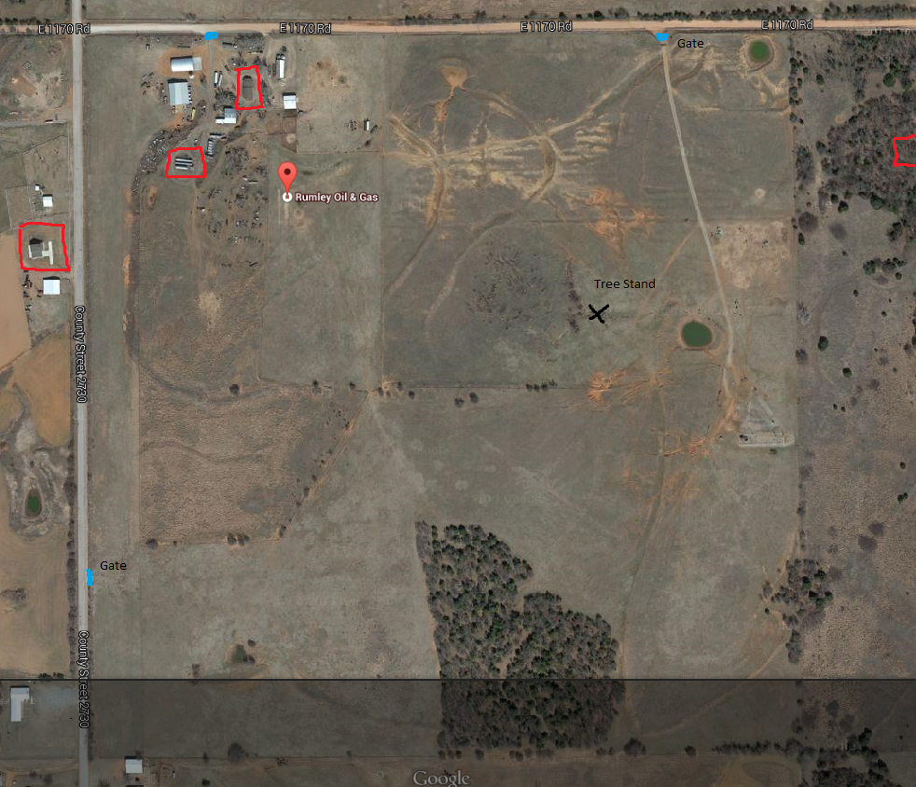

Slide 17
Other Potential Lease Clauses
Miscellaneous Clauses
  Venue (be careful with form leases)
  Forum
  Attorney fees
  Dispute resolution (mediation, ADR, suits)
  Anti-partnership clause

Slide 18
Grazing Leases
Grazing
  Stocking requirements based on species/size
  Use of vehicles
  Security deposit
  Fence maintenance (!!!)
  Care of livestock
  Vaccination requirement – bang’s & blackleg
  Hunting rights?

Slide 19
Hunting Leases
What can the tenant do on the property?
  Hunt (what species)
  Fish
  Camp (fires)
  Invite guests
  Ride ATVs
  Tree stands
  Bag limits
Require lease and liability waivers from all persons present.

Slide 20
Livestock Leases
Security deposit
Owner representations re: health of animal
Lessee representations re: health of herd
Liability during transport of the animal
Death, injury, or illness
Feed and nutrition

Slide 21
Additional Information
Ranchers’ Agricultural Leasing Handbook
http://agrilife.org/texasaglaw/2016/07/05/ranchers-leasing-handbook/
Ag Lease 101 website
http://www.aglease101.org

Slide 22
Thanks!
Tiffany Dowell Lashmet
Email: Tiffany.DowellLashmet@ag.tamu.edu
Shannon L. Ferrell
Email: shannon.l.ferrell@okstate.edu

