Slide 1
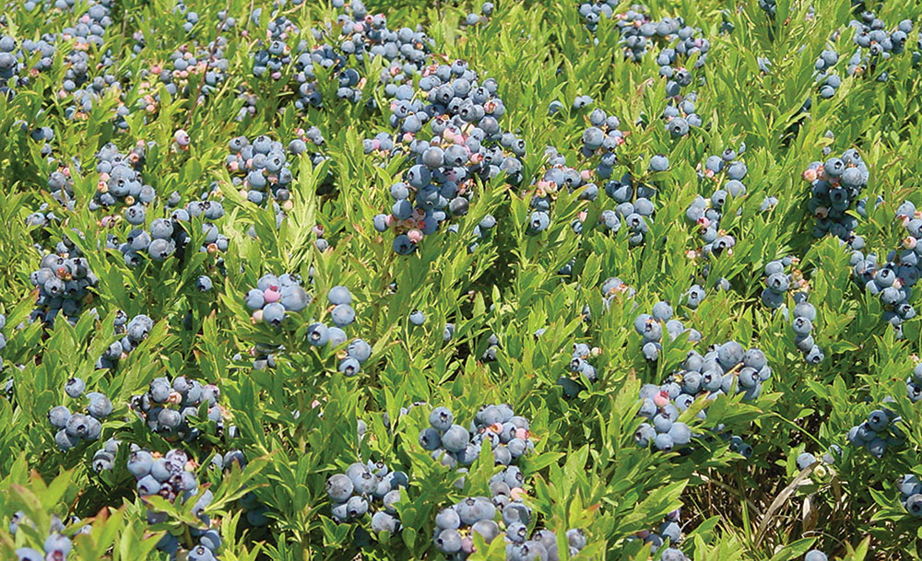


Blueberry Crop Insurance:
Options & Updates
Erin Roche
UMaine Cooperative Extension
Crop Insurance Education Program
July 15, 2015
Notes:
Our program goal is not to sell farmers crop insurance rather it is to inform them of options and changes to the policies.
Crop insurance is one way to ensure a reliable level of cash flow as we endure some of the weather variability Ivan discussed

Slide 2
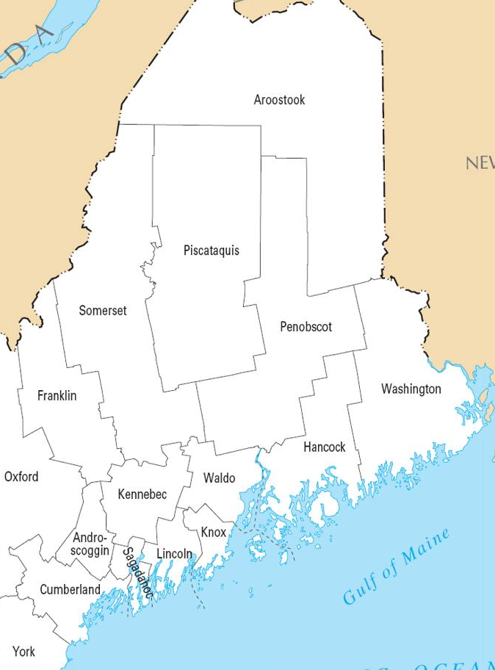
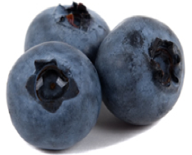
Insurable Eligibility
  Lowbush types
  Yield 1,000 lb ac⁻¹ -or- 2nd growing season after pruning
  Acreage inspection required
Insurance available
in 8 counties
Notes:
To be eligible for blueberry CI you must be growing lowbush types that are in the 2nd growing season after pruning or yield 1,000 lbs or more
An acreage inspection is required to determine eligibility.
Coverage available in 8 counties, others coverage is available with written agreement or NAP

Slide 3
APH Coverage Levels
 | Coverage |  | Producer Cost
Level | Yield | Price* | Premium | Admin
CAT | 50% | 55% | $0 | $300
BUY-UP | 50-75% | 100% | Varies | $30
* 2015 price is $0.56 lb⁻¹, CAT price is $0.31 lb⁻¹
Notes:
Crop insurance for blueberries is based on your Actual Production History (APH), or your average yield per acre based on your historical records
With this policy you choose how much of your average yield you would like to guarantee, if you fall below that guarantee a loss payment is triggered
The catastrophic level of coverage is the minimal coverage and provides 50% yield guarantee with losses paid at 55% of the indemnity price.
The next levels of coverage is Buy-Up, you determine how much of your yield you’d like to guarantee with levels ranging from 50% to 75% at 5% increments. Losses are paid at 100% of established price, which is $0.56/lb for 2015
Fees are per crop per county.

Slide 4
Blueberry Loss Example
 | CAT | Buy-Up 65%
Approved Yield (lbs ac⁻¹) | 3,500
Elected Coverage | x 0.50 | x 0.65
Yield Guarantee (lbs ac⁻¹) | = 1,750 | = 2,275
If actual yield falls below guarantee, a loss payment is triggered
Notes:
Running some loss scenarios with different coverage levels can help you to determine what level of coverage you need for adequate cash flow
Here we compare CAT to Buy-up at 65% yield protection
Start with average historical yield of 3,500 lbs/ac. This is a yield based on your previous production years. Multiply approved yield times the elected coverage gives us the yield guarantee
If your production dips below this guarantee, a loss payment will be triggered.
Obviously if you elected for a greater level of coverage, your yield guarantee will increase

Slide 5
Blueberry Loss Example
 | CAT | Buy-Up 65%
Approved Yield (lbs ac⁻¹) | 3,500
Elected Coverage | x 0.50 | x 0.65
Yield Guarantee (lbs ac⁻¹) | = 1,750 | = 2,275
Actual Yield (lbs ac⁻¹) | 1,000
Insurable causes of loss:
- Adverse weather
- Wildlife
- Insect and plant disease
Notes:
Say we have an insurable loss and our actual yield is 1,000 lbs. An insurable cause of loss could be due to adverse weather conditions such as drought, excess moisture, frost, freeze.
Wildlife, insect and plant disease only if proper control methods were taken

Slide 6
Blueberry Loss Example
 | CAT | Buy-Up 65%
Approved Yield (lbs ac⁻¹) | 3,500
Elected Coverage | x 0.50 | x 0.65
Yield Guarantee (lbs ac⁻¹) | = 1,750 | = 2,275
Actual Yield (lbs ac⁻¹) | 1,000
Lbs ac⁻¹ below Guarantee | 750 | 1,275
Amount loss payment calculated on
Notes:
The yield guarantee minus actual yield is the amount our loss payment will be calculated on

Slide 7
Blueberry Loss Example
 | CAT | Buy-Up 65%
Approved Yield (lbs ac⁻¹) | 3,500
Elected Coverage | x 0.50 | x 0.65
Yield Guarantee (lbs ac⁻¹) | = 1,750 | = 2,275
Actual Yield (lbs ac⁻¹) | 1,000
Lbs ac⁻¹ below Guarantee | 750 | 1,275
Indemnity Price | x $0.31 | x $0.56
Gross Indemnity ($ ac⁻¹) | $233 | $714
Notes:
Multiplying this amount times the price election is the gross indemnity.

Slide 8
Blueberry Loss Example
 | CAT | Buy-Up 65%
Approved Yield (lbs ac⁻¹) | 3,500
Elected Coverage | x 0.50 | x 0.65
Yield Guarantee (lbs ac⁻¹) | = 1,750 | = 2,275
Actual Yield (lbs ac⁻¹) | 1,000
Lbs ac⁻¹ below Guarantee | 750 | 1,275
Indemnity Price ($ lb⁻¹) | x $0.31 | x $0.56
Gross Indemnity ($ ac⁻¹) | $233 | $714
Est. Coverage Cost ($ ac⁻¹) | - $0 ($300) | - $55
Net Indemnity ac ⁻¹ | $233 | $659
Notes:
To see our net indemnity we subtracting the premium. Which for the CAT plan is just the admin fee and for buy up is $55/ac
The producer premium varies based on your approved yield and ranges from ($25/ac at the 50% level to $100/ac at the 75% level)
Our net indemnity, which is around $200 for the CAT and $650 for the buy-up
(Premium rate = the Approved yield x elected coverage x price elected x premium rate (varies by crop/county) x subsidy factor (41% for 65% coverage)

Slide 9
Blueberry Loss Example
 | CAT | Buy-Up 65%
Approved Yield (lbs⁻¹ ac) | 3,500
Elected Coverage | x 0.50 | x 0.65
Yield Guarantee (lbs⁻¹ ac) | = 1,750 | = 2,275
Actual Yield (lbs⁻¹ ac) | 1,000
Lbs below Guarantee | 750 | 1,275
Est. Price | x $0.31 | x $0.56
Gross Indemnity ($⁻¹ ac) | $233 | $714
Est. Coverage Cost ($⁻¹ ac) | - $0 ($300) | - $55
Net Indemnity⁻¹ ac | $233 | $659
But will this Coverage:
  Give adequate cash flow?
  Complement marketing plan?
  Meet debt obligations?
Notes:
But ultimately its up to you to figure out how much of your crop values are protected
For instance will this coverage give you cash flow needed to cover production costs?
* Make rent or mortgage payment?
* Will this coverage give you flexibility with your marketing plan?
And if you have debts, will it allow you to make payments?

Slide 10

Blueberry Retrospective
Notes:
As well, sometimes looking into the past can inform our future risk management decisions

Slide 11
Blueberry Loss History
CAT Policy
Notes:
Here we have an 11-year overview of CAT policies in Maine, comparing the $ amount producers paid in for CAT (in gray) versus the $ amount paid to producers for insurable loss
Some years (2006-2009) the producers paid in more for coverage
And then in some years we see payments made to growers for loss

Slide 12
Blueberry Loss History
CAT Policy
Frost
Notes:
These were tough years due to winter injury, excessive springtime moisture, and frost in 2010.

Slide 13
Blueberry Loss History
CAT Policy
Notes:
These events were so extreme we found CAT policies paid $1.39 out per every $1.00 of producer fee.
The point is a loss may happen 3 or 4 times out of a decade but having some sort of safety net in place can protect the viability of your business

Slide 14
Blueberry Loss History
Buy-Up Policy
BUY UP paid ~$2.58 per
$1.00 of producer premium
Notes:
Looking at buy- up policies over the last 11 years, we see the producer premium in orange and the paid indemnities in purple.
By protecting crop values at a higher buy-up level, in most years paid growers $2.58 for every $1.00 they put in.
At a greater level of coverage, losses were triggered 10/11 years, whereas with CAT losses were triggered 4/11 years we’re seeing losses are triggered more frequently

Slide 15
Important Dates:
Sales Closing: November 20, 2015
Production & Acreage Report: Jan. 15
Premium Billing: August 15
Direct Marketing: 15 days before harvest
  Notify Agent within 72 hrs of loss
Notes:
Important Dates- never too early to meet with an agent, don’t wait until last minute
Acreage report- current years acreage
Production report- previous years production

Slide 16
2014 Farm Bill Changes
Notes:
2014 Farm Bill brought a number of changes to crop insurance

Slide 17
Beginning Farmer Benefits
    CAT admin fee waived
    +10% points of premium subsidy to BUY UP
    Increased substituted yield for yield adjustment
Notes:
Anyone who has been farming less than 5 years
Also Benefits for Farmers with Limited Resources
The administrative fee will be waived if you request it and if you qualify as a limited resource farmer

Slide 18
Whole Farm Revenue Protection Policy
    Covers all farm commodities (crop, livestock, resale)
    Protects against yield and price loss of whole farm revenue
    Coverage levels from 50-85% of expected revenue
Notes:
WFRP- rolled out Nov 2014, Sales closing date March 15
The new WFRP will offer a whole-farm premium subsidy to farms with two or more commodities at a level similar
to single-crop policies. Producers can choose coverage levels from 50 to 85% and cover up to $8.5 million of revenue.
May be good for diversified farms
For 2015, the coverage will be based on:
Lower of either the average of adjusted gross revenue from 2009-2013 as derived from the producer’s Inter
nal Revenue Service (IRS) tax forms; OR The adjusted expected gross revenue for the 2015 insurance year.
Losses occur when the Allowable Revenue from the production of commodities produced during the insurance year,
falls below the Insured Revenue.
Opportunity to also purchase Multi-Peril Crop Insurance (MPCI) buy-up policies for selected individual crops
MAJOR BENEFITS OF WFRP
A means to insure crops and livestock products that have unique higher values destined for specialty markets
such as seeds, organic, special varieties, local, and grass-finished.
Potentially lower costs for insurance because of the ability to either mix and match WFRP coverage with other
multi-peril insurance products or because of the inherent lowering of risks, and hence premium costs, due to
increased diversification of products sold.
Gives the producer the opportunity to limit the risk of exploring new markets for specialty crop and livestock
products.
High levels of coverage and federal support for premium costs.

Slide 19
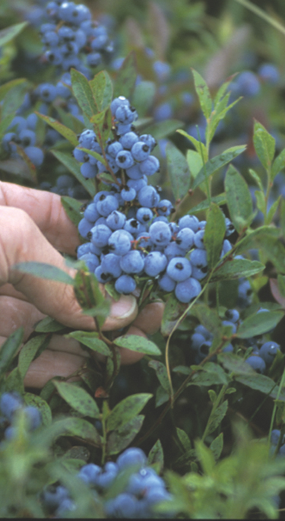
Take Away
How much of your crop values are protected?
What is your Risk Management strategy?
Notes:
Take the time to do the numbers and figure out how much of your crop values are protected
Questions to ask yourself
How much risk exposure do I have?
What should my ideal safety net accomplish?
* Cover production costs?
* Cover pre-harvest sales contract?
* Replace livestock feed?
* Make rent or mortgage payment?
* Contribute to family living expenses?
* Secure Ag loan?
* Other?
* How much protection do I need?
* Do I prefer revenue protection or yield protection?
* At what percentage of crop loss should my payment trigger?

Slide 20
Resources
UMaine Risk Management and Crop Insurance
http://umaine.edu/agriculture/maine-risk-management-and-crop-insurance-education-program/
USDA Risk Management Agency (RMA)
http://www.rma.usda.gov/
University of Maine Cooperative Extension
495 College Ave
Orono, ME 04473
207.949.2490 • erin.roche@maine.edu
http://umaine.edu/agriculture/maine-risk-management-and-crop-insurance-education-program/
The University of Maine is an equal opportunity/affirmative action institution.

