Slide 1
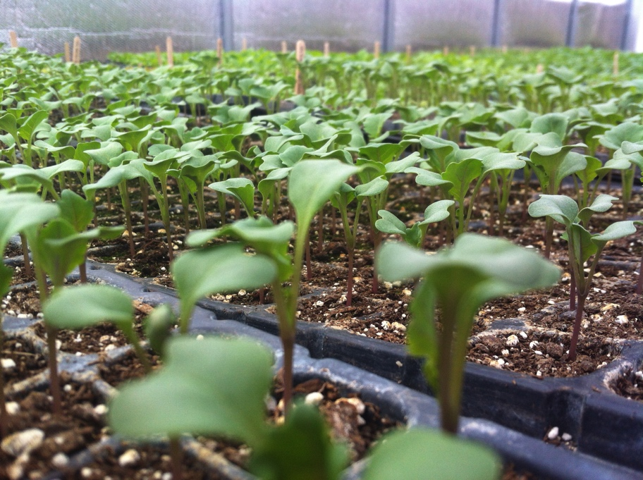

Do I Need Crop Insurance?
Financial Assurance for Beginning Farmers
Using USDA Risk Management Programs

Slide 2
Farming is Risky Business
Crops can fail for a variety of reasons. This chart shows causes of crop failure and the percentage of total crop insurance claims for each category.
The increased volatility of the weather, uncontrollable plant diseases and insect damage increases the likelihood of extreme events that can wreck a business plan, making it more important than ever to have an income-assuring protection plan in place for each growing season.

Slide 3
Financial Disaster Protection Can:
Help to prevent a major business financial interruption by assuring that you get your input costs back;
Generate funds to buy replacement production to maintain your customer base;
Pay off your operating loan and help you to farm again next year; an
Assist with family living expenses when disaster occurs.

Slide 4
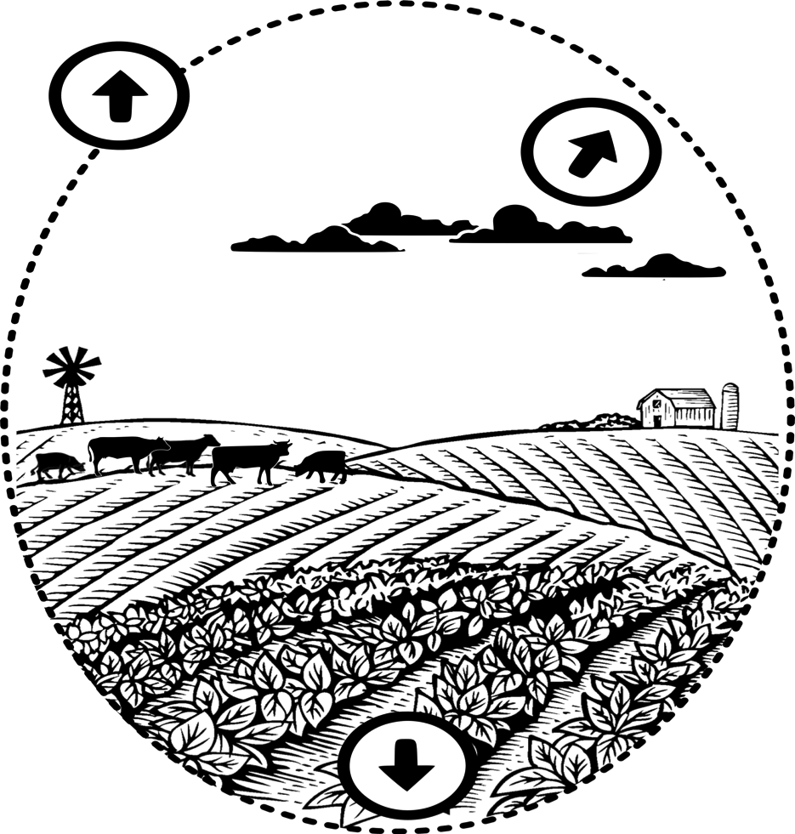
Overview of Programs
Whole Farm Revenue Protection
[WFRP]
Non-insured Crop Disaster Assistance Program [NAP]
Each producer is personally responsible to develop a risk management plan for their farm(s) before enrollment deadlines. USDA provides tools for YOUR consideration.
Individual crops, Multi-peril Crop Insurance [MPCI]

Slide 5
Farm Bill Safety Nets
A farmer can choose:
  Crop Insurance, Whole Farm Revenue Protection (WFRP)
  Available from Crop Insurance Agents through the USDA Risk Management Agency (RMA) (www3.rma.usda.gov/apps/agents/)
OR
  Non-insured Crop Disaster Assistance (NAP) [if crop insurance is not available], Agricultural Risk Coverage (ARC), Price Loss Coverage (PLC)
  Available from USDA Farm Service Agency (FSA) (fsa.usda.gov)

Slide 6
Crop Insurance Programs
Protection Plans for almost all crops and some livestock (Provide protection not covered by the ARC or PLC programs)
  Apples  Small Grains
  ❖ Blueberries  Nursery
  ❖ Corn  Forage Seeding
  ❖ Green Peas  Organic Crops
  ❖ Market Fresh Sweet Corn  WFRP
  ❖ Potatoes
Can significantly reduce risk exposures to manageable levels to minimize financial interruptions when disasters occur.
Provided with federal cost sharing to make the protection more affordable.
Crop Insurance Protection is available for up to 75% of your yield history (85% for some crops) on many crops and some livestock.
*New Farm Bill has added improvements, including benefits for new/beginning and organic producers.
FMI: Crop insurance Agents http://www.rma.usda.gov/tools/agent.html, http://www.fsa.usda.gov/

Slide 7
Crop Insurance Programs
Whole Farm Revenue Protection
Provides a risk management safety net for all commodities on the farm under one insurance policy.
Provides protection against the loss of insured revenue due to an unavoidable natural cause of loss, that occurs during the insurance period and will also provide carryover loss coverage if you are insured the following year.
Includes farms with specialty or organic commodities (both crops and livestock), or those marketing to local, regional, farm-identity preserved, specialty, or direct markets.
FMI: Crop insurance Agents http://www.rma.usda.gov/tools/agent.html, http://www.fsa.usda.gov/

Slide 8
Protection Plans from USDA FSA for general field crops with FSA base acres:
County and Individual Ag Revenue Coverage (ARC)
  Provides up to 65% or 85% of revenue losses between 76% and 86% of historical revenue for eligible crop losses for crops with FSA base acres (maximum payment of 6.5% or 8.5% respectively).
  This protection is available at no cost to you.
Price Loss Coverage (PLC)
  Provides protection when market prices are less than reference prices for crops with FSA base acres.
  This foundation protection is available at no cost to you.
Non-insured Crop Disaster Assistance (NAP)
  NAP Provides similar protection as crop insurance for most crops, at up to 65% of your yield history when a crop insurance policy is not available. January 14 enrollment.
FMI: County Farm Service Agency Offices (FSA/USDA); http://www.fsa.usda.gov/

Slide 9
Protection for YOUR Farm
Each producer is personally responsible to develop a risk management plan for their farm(s) before enrollment deadlines. USDA provides tools for YOUR consideration.
Crop Insurance, NAP & ARC (PLC) Protection (areas where SCO is not available) % Level of Coverage
* Price Loss Coverage (PLC) available in lieu of ARC on Program crops with base acres at FSA
Is YOUR Risk Management Plan Adequate to Manage a Disaster Related Business Interruption?

Slide 10
Protection for YOUR Farm
Crop Insurance & NAP Protection For Fruits and Vegetables (FSA non-program crops) % Level of Coverage
Each producer is personally responsible to develop a risk management plan for their farm(s) before enrollment deadlines. USDA provides tools for YOUR consideration.
Be sureto consider the benefits of the improved NAP protection with Buy-Up protection that is available on almost non-insurable crops!
Is YOUR Risk Management Plan Adequate to Manage a Disaster Related Business Interruption?

Slide 11
How much crop value and risk are covered by ARC?

Slide 12
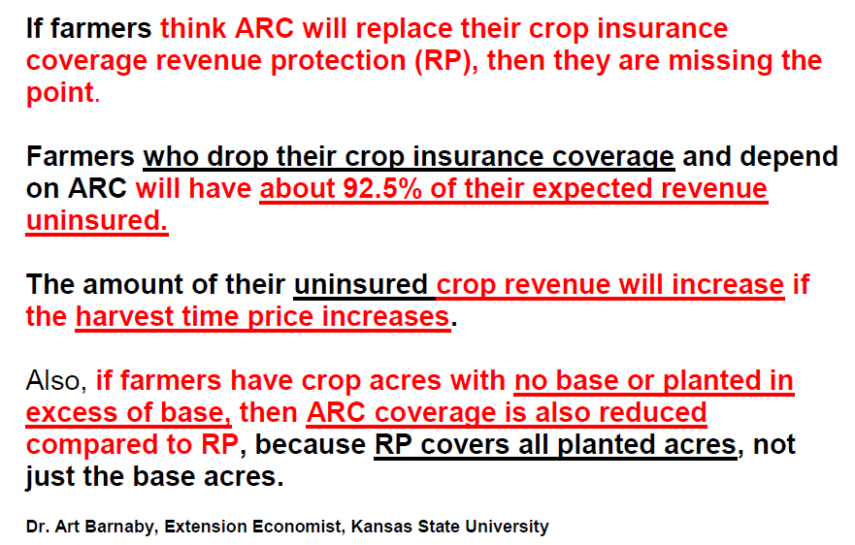
Most producers will need more protection than ARC
Notes:
Should this be 91.5% instead of 92.5%?

Slide 13
The “Sum of the Parts” - Protection for YOUR Farm
Each producer is personally responsible to develop a risk management plan for their farm(s) before enrollment deadlines. USDA provides tools for YOUR consideration.
Crop Insurance, NAP & ARC (PLC) Protection (areas where SCO is not available) % Level of Coverage
* Price Loss Coverage (PLC) available in lieu of ARC on Program crops with base acres at FSA
Is YOUR Risk Management Plan Adequate to Manage a Disaster Related Business Interruption?

Slide 14
Producers Crop Safety Net Worksheet
Obtain Farm Bill Safety Net Options and advice from crop insurance agents, your county Farm Service Agency office, NRCS Representatives and University of Maine Cooperative Extension Ag Educators.
By utilizing the table we are getting a handle on the information needed to respond to the following questions:
Crops I Plan to Grow | Estimated Input Costs | Estimated Expected Value | Protection Choices Available | Protection Choices I’m Considering | Notes
What am I likely to enroll in? PLC, ARC, Crop insurance/NAP, WFRP ?
How much risk exposure do I have?
What should my ideal safety net accomplish?
* Cover production costs?
* Cover pre-harvest sales contract?
* Replace livestock feed?
* Make rent or mortgage payment?
* Contribute to family living expenses?
* Secure Ag loan?
* Other?
* How much protection do I need?
* Do I prefer revenue protection or yield protection?
* At what percentage of crop loss should my payment trigger?

Slide 15
Farm Bill Improvements - Crop Insurance
For Beginning, Limited Resource and Traditionally Underserved Crop Farmers
More protection choices
Improved organic protection
  Organic elections availability for more crops
  Extended organic price coverage for 2014 to eight additional crops (oats, peppermint, apricots, apples, blueberries, almonds, pears, and grapes for juice) to a total of sixteen. (Producer has the option of using organic or conventional prices.)
  RMA has removed the 5% premium surcharge for organic price options.
New benefits for beginning farmers (first 5 years of insurable crops)
  Additional 10 percentage points of premium subsidy for additional coverage policies (buy-up) that have premium subsidy
  Exemption from paying the administrative fee for catastrophic (CAT) and additional coverage (buy-up) level policies
  Use of the production history of farming operations, if beginning farmers were previously involved in the decision making or physical activities
  An increase in the substituted yield for yield adjustment, which allows a replacement of a low yield due to an insured cause of loss, from 60% to 80% of the applicable transitional yield (T-Yield) for the crop in the county

Slide 16
Farm Bill Improvements – Crop Insurance
For Beginning, Limited Resource and Traditionally Underserved Crop Farmers
Benefit for farmers with limited resources
  Administrative fee will be waived if you request it and if you qualify as a limited resource farmer (as defined by USDA at http://www.lrftool.sc.egov.usda.gov/LRP_Definition.aspx).
5. Improved whole farm revenue protection – features include the following
  Covers all farm commodities including animal and animal products revenue including commodities purchased for resale (limit up to 50% of total expected revenue). (No protection for timber forest, forest products and animals for sport, show or pets.)
  Coverage levels from 50% to 85% of expected revenue (Covers minimum market readiness costs.)
  Covers natural causes of loss and declining market prices within the insurance year
  Premium subsidies vary from 55% to 80%.
  Opportunity to also purchase Multiple Peril Crop Insurance (MPCI) buy-up policies for selected individual crops

Slide 17
Farm Bill Improvements – NAP
For Beginning, Limited Resource and Traditionally Underserved Crop Farmers
Improved NAP – Up to 65% coverage level and 100% of the established price for most non-insurable crops
New benefits for beginning farmers
  A farmer or rancher entity or joint operation, who has not actively operated and managed a farm or ranch for more than 10 years, and materially and substantially participates in the operation. For legal entities to be considered a beginning farmer or rancher, all members must be related by blood or marriage and all the members must be beginning farmers or ranchers.
  The NAP administrative fees do not apply if you meet the definition of a beginning farmer, limited resource farmer, and traditionally underserved* farmer.
  The premium for limited resource, beginning and traditionally underserved* farmers is 50% of the premium.

Slide 18
Farm Bill Improvements – NAP
For Beginning, Limited Resource and Traditionally Underserved Crop Farmers
*Traditionally Underserved - Socially disadvantaged farmer definition:
A farmer or rancher who is a member of a group whose members have been subjected to racial, ethnic, or gender prejudice because of their identity as members of a group, without regard to their individual qualities. Socially disadvantaged groups include the following, and no others unless approved in writing by the Deputy Administrator:
  American Indians or Alaskan Natives,
  Asians or Asian-Americans,
  Blacks or African-Americans,
  Hispanics or Hispanic-Americans,
  Native Hawaiians or other Pacific Islanders, and
  Women.
*For legal entities requesting to be considered Socially Disadvantaged, the majority interest must be held by socially disadvantaged individuals.

Slide 19
Farm Bill Improvements – Micro-Loans
For Beginning, Limited Resource and Traditionally Underserved Crop Farmers
Expanding eligibility and increasing lending limits to help more beginning and family farmers.
The borrowing limit is increased from $35,000 to $50,000.
Loan types include: production operations, machinery and breeding stock, farm real estate (purchase and make improvements, and land development to promote soil and water conservation)
The lending process is simplified.
Updating required “farming experience” to include other valuable experiences
Expanding eligible business entities to reflect changes in the way family farms are owned and operated
Help more people who are considering farming and ranching, or who want to strengthen their existing family operation

Slide 20

The alternative to having crop insurance & NAP
University of Maine Cooperative Extension
Tori Jackson
207.353.5550 • tori.jackson@maine.edu
http://umaine.edu/agriculture/maine-risk-management-and-crop-insurance-education-program/
The University of Maine is an equal opportunity/affirmative action institution.

