Slide 1
Peanuts and Rice
2014 Farm Bill Education Conference
Kansas City Airport Hilton Hotel
Kansas City, Missouri
September 3-4, 2014
Nathan Smith, PhD
Extension Economist
Agricultural and Applied Economics

Slide 2
Commodity Programs and Peanuts
The Peanut Program had it’s own subtitle before 2002. A supply control program commonly referred to the Peanut Quota Program was in place going as far back as the 1942.
Peanuts became a covered commodity in the 2002 Farm Bill when the quota program was repealed.
Peanut is included in the commodities programs of the 2014 Farm Bill.

Slide 3
Marketing Assistance Loan
Loan Program w/ LDP and MLG remains essentially the same:
No Sequestration applied to MAL.
Peanut Storage, Handling and Associated Cost
  No change from 2008 Farm Bill
 | 2008 | 2014
Peanut | $355/ton | $355/ton
Rice
Long Grain | $6.50/cwt | $6.50/cwt
Medium Grain | $6.50/cwt | $6.50/cwt

Slide 4
Payment Limits
Payment limit per person or legal entity $125,000 for PLC, ARC, and MLG/LDP
Loan forfeitures do not apply to MLG
Spousal rule applies doubling to $250,000
Equal and separate limit for peanuts

Slide 5
Crop Insurance
Peanut Revenue Insurance:
  Mandates availability for 2015 crop
  Under review by FCIC of RMA
  Board meets in September
Supplemental Coverage Option (SCO):
  Available for commodities enrolled in PLC
  65% subsidy
  Will not be available in 2015 for Peanuts

Slide 6
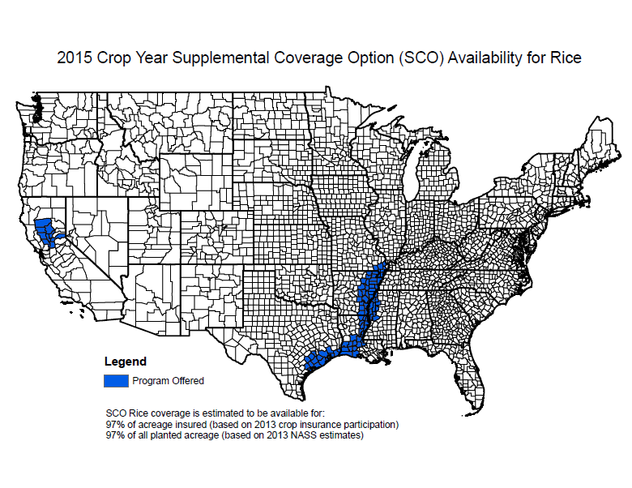

Slide 7
What Are the Main Decisions
for Peanuts and Rice?
Covered Commodity Bases: Retain or Reallocate
Payment Yield (for PLC): Retain or Update
PLC vs ARC-C vs ARC-I (Known as Producer Election)
SCO crop insurance (if PLC is chosen)

Slide 8
Base Reallocation Example
100
Cotton
50
Peanuts
20
Corn
20
None
= 200 acres total
100 acres cotton/generic base
80 acres other bases
10 Wheat
130 Acres Planted (> available bases)
80/130 x 65 = 40 acres allocated to corn
80/130 x 65 = 40 acres allocated to peanuts
50%
50%
100
Generic
40
Peanuts
40
Corn
Reallocated Bases Would Be
40
Corn
20
None
Original Example Courtesy of Dr. Stanley Fletcher, UGA

Slide 9
Generic Base
Cotton Base becomes Generic Base.
Generic Base does not change during the life of the Farm Bill.
Can be used on a year-to-year basis to temporary allocate to a covered commodity (excluding cotton) planted.
A covered commodity must be planted to be eligible for any generic base allocation.

Slide 10
Generic Base Example
Use Previous Reallocated Base Farm Example
50
Peanuts
100
Generic
50
Corn
40
Peanuts
40
Corn
20
None
= 200 acres
In 2014, assume the producer plants:
  65 peanut acres
  65 corn acres
  70 cotton acres
  200 acres total
130 acres covered commodities > 100 Generic base acres
65/130 x 100 = 50 acres assigned to peanuts
65/130 x 100 = 50 acres assigned to corn
(40 base + 50 generic) = 90 total peanut base acres
(40 base + 50 generic) = 90 total corn base acres
Can have more total base than planted in a year because Crop Base (non-generic) does not have to be planted.

Slide 11
Opportunity to Update Yields
PLC Payment Yield (assumed to be the CCP Yield)
Landowner has 1-time option to update yields on a crop-by-crop, farm by farm basis.
May retain current yield or update.
90% of the 2008-2012 average yield per planted acre.
Peanut Example
 | Production | Acres Planted | Yield Per Acre
2008 | 760,000 | 200 | 3,800
2009 | 410,000 | 100 | 4,100
2010 | 500,000 | 125 | 4,000
2011 | 352,500 | 75 | 4,700
2012 | 1,120,000 | 224 | 5,000
5-Yr Average Yield |  |  | 4,320
90% of Average Yield |  |  | 3,888

Slide 12
Opportunity to Update Yields
Peanut Example
 | Production | Acres Planted | Yield Per Acre
2008 | 760,000 | 200 | 3,800
2009 | 410,000 | 100 | 4,100
2010 | 500,000 | 125 | 4,000
2011 | 0 | 0 | -
2012 | 1,120,000 | 224 | 5,000
Average Yield |  |  | 4,225
90% of Average Yield |  |  | 3,803
Peanut Example
 | Production | Acres Planted | Yield Per Acre
2008 | 0 | 0 | -
2009 | 410,000 | 100 | 4,100
2010 | 0 | 0 | -
2011 | 0 | 0 | -
2012 | 1,120,000 | 224 | 5,000
Average Yield |  |  | 4,550
90% of Average Yield |  |  | 4,095
What if did not plant covered commodity every year?
Exclude any crop year acreage planted was zero.

Slide 13
PLC vs ARC-C vs ARC-I

Slide 14
Price Loss Coverage (PLC)
Reference Price
PLC Payment made on 85% of Base Acres
Notes:
OK.
If you elect Price Loss Coverage (PLC), the payment will be generated off what is called the Reference Price. This is similar to the Effective Price (TP minus DP) under the old farm bill CC program.
Here we can compare the new Reference Price with the previous Effective Price. A PLC Payment is generated when the market falls below the Reference Price.
The Reference Price is > the previous Effective Price for all the crops shown.

Slide 15
Price Loss Coverage (PLC)
PLC Rate = Reference Price - higher of Average Market Price or Loan Rate
PLC Payment = PLC Rate x Payment Yield x Base Acres x 85%
Peanut Example:
Average Market Price = $500
Payment Yield = 3,800 (1.9 tons)
Base Acres = 100 acres
PLC Rate = $535 - higher of $500 or $355 = $35/ton
PLC Payment = $35/ton x 1.9 tons x 100 ac x 85% = $5,652.60
($56.53 per base acre)
Payment made after October 1 of the following year.
Notes:
Here’s the PLC math……………
And a peanut example.

Slide 16
NASS Marketing Year Average Price for Peanuts
Year | $/Lb | $/Ton
2013 | 0.249 | 498*
2012 | 0.301 | 602
2011 | 0.318 | 636
2010 | 0.225 | 450
2009 | 0.217 | 434
2008 | 0.23 | 460
*August 28, 2014

Slide 17
Price Considerations for PLC
$535 Reference Price applies to 85% of Base acres.
Payment Yield less than Expected/Actual Yield.
National Marketing Year Average Price higher than contract/cash price for runners.
The more acres planted than base acreage, the lower the average price per ton.
Payments not received until October 1 or later of the next year. (i.e. Oct 2015 for 2014 crop).

Slide 18
Overplant/Low Price PLC Example
Georgia State Average Yield
  2008-2012 = 3,365 lbs per acre (90%)
  2012-2013 = 4,505 lbs per acre
  Difference = 1,140 lbs per acre
Overplant peanuts
  $535 - $355 = $180 per ton
  85% x $180 = $153 per ton
$153 x 1.6825 tons (3,365 lbs) = $257.43 per base acre
$355 x 2.2525 tons (4,505 lbs) = $799.64 per base acre
Total per base acre = $1057.07 or $469.29 per ton
Notes:
Here is an example for wall-to-wall peanuts scenario.

Slide 19
ARC-County, Peanut Example
Payment received on 85% of Base Acres,
not before October 1 of the following year

Slide 20
ARC Individual Coverage
Not going to be an option in most cases for peanut and rice farms due to diverse crop mixes and likelihood of PLC payments.
Notes:
IF selecting ARC on an individual/actual farm basis, here’s how it works……..
(GO OVER)
Payment is on only 65% of Base compared to 85% for County Coverage.

Slide 21
Stochastic Simulation Model of Program and Crop Insurance Decision – Peanut Farm Example
Stochastic simulation model of net revenue developed by Todd D. Davis, University of Kentucky and John D. Anderson – American Farm Bureau Federation ®
Irrigated & non-irrigated peanuts for a Worth County, Georgia farm.
Simulate stochastic farm yield, county yield, crop insurance projected price and marketing-year average price for peanuts for a five-year farm bill.
Yield and price distributions used to generate distributions of crop revenue, YP indemnities, ARC (C and I), PLC, and SCO payments.

Slide 22
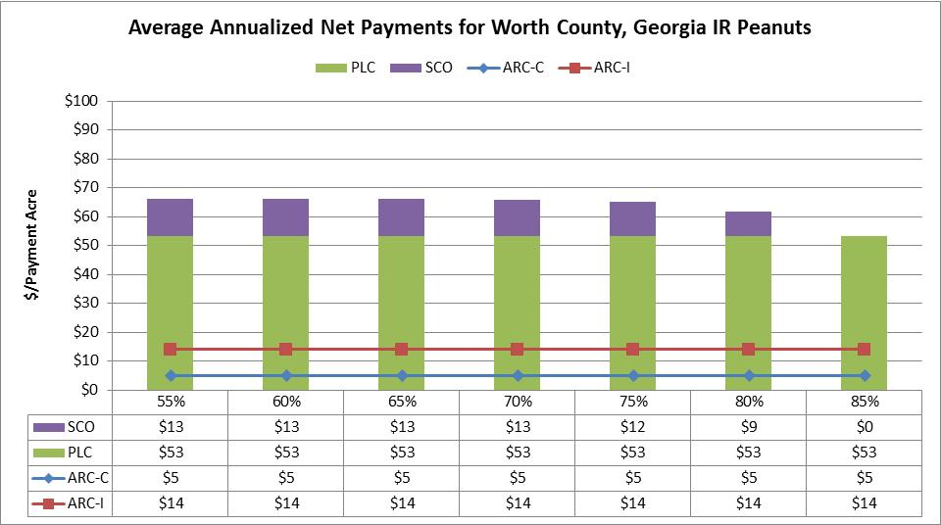
Irrigated Peanuts

Slide 23
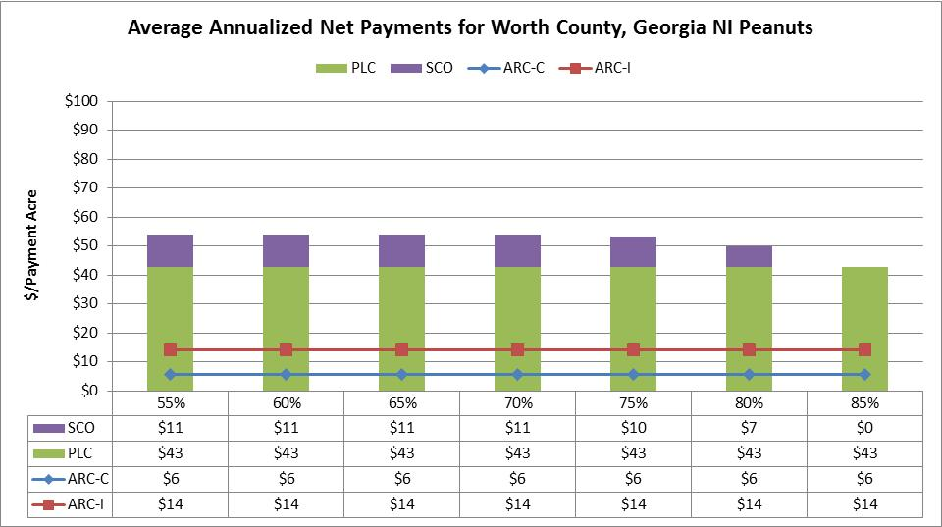
Non-Irrigated Peanuts

Slide 24
Summary of Changes for Rice
Eliminates same programs as has already been discussed (Direct Payments, DCCP, ACRE, & SURE)
Retains marketing loan rate of $6.50/cwt
Rice is eligible for ARC or PLC
  PLC Reference Price of $14/cwt for long- and medium-grain
  SCO is available with PLC election
  County-level or Farm-level option with ARC
Source: John Michael Riley, Mississippi State University

Slide 25
NASS Marketing Year Average Price for Rice ($/cwt)
Year | All Rice | Long Grain | Mdm/Short Grain
2013 | $15.90* | $15.40* | $17.80*
2012 | $15.10 | $14.50 | $17.40
2011 | $14.50 | $13.40 | $17.10
2010 | $12.70 | $11.00 | $18.80
2009 | $14.40 | $12.90 | $18.40
2008 | $16.80 | $14.90 | $24.80
Source: USDA NASS, slide by John Michael Riley, Mississippi State University
*August 28, 2014

Slide 26
Rice Price Forecast (all rice, $/cwt)
Year | USDA (Feb) | FAPRI (Aug) | CME Group (Sep 2)
2014 | $15.30 | $13.87 | $12.51
2015 | $15.60 | $13.39 | $13.025
2016 | $15.70 | $13.21 | n/a
2017 | $15.80 | $13.17 | n/a
2018 | $15.90 | $13.24 | n/a
Source: USDA, FAPRI U. of Missouri, and CME,
slide by John Michael Riley, Mississippi State University

Slide 27
Price Loss Coverage (PLC) Rice Example
This example uses a base yield of 6,300 pounds per acre and the values shown are payment estimates for a planted acre on an eligible base acre. Your values would change depending on your farm’s base yield.
Source: USA Rice, slide by John Michael Riley, Mississippi State University

Slide 28
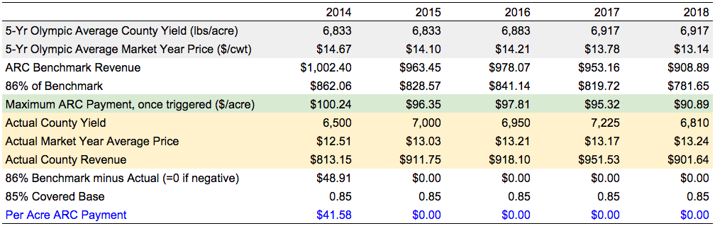
Ag Risk Coverage (ARC) Rice Example (!!)
Note: Uses CME Group forecast for 2014 & 2015, FAPRI Forecast for 2016-2018
Marketing Year Average Prices:
2009 -- $14.40
2010 -- $12.70
2011 -- $14.50
2012 -- $15.10
2013 -- $15.90
28
Source: slide by John Michael Riley, Mississippi State University

Slide 29
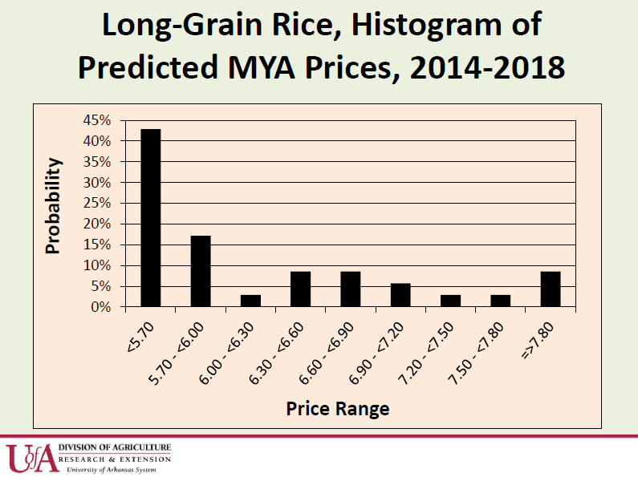
Archie Flanders, University of Arkansas,
Northeast Research and Extension Center, Keiser, AR

Slide 30
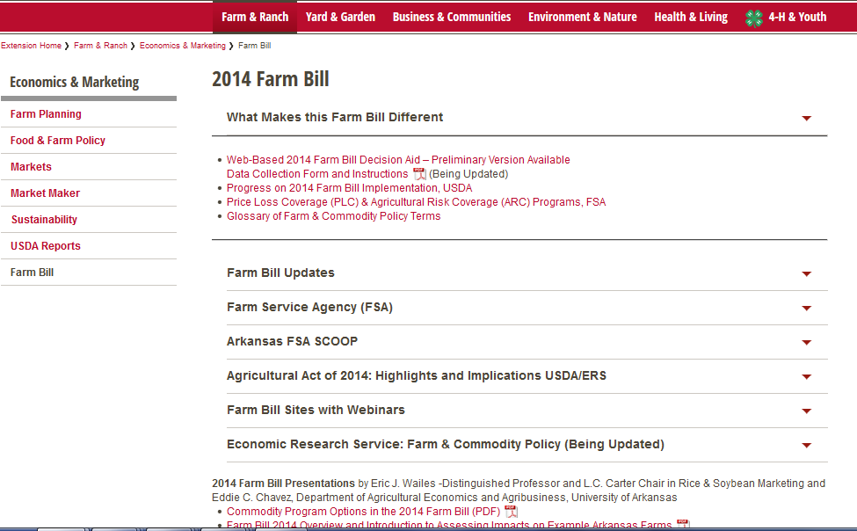
University of Arkansas Rice Examples
http://www.uaex.edu/farm-ranch/economics-marketing/farm-bill/

Slide 31
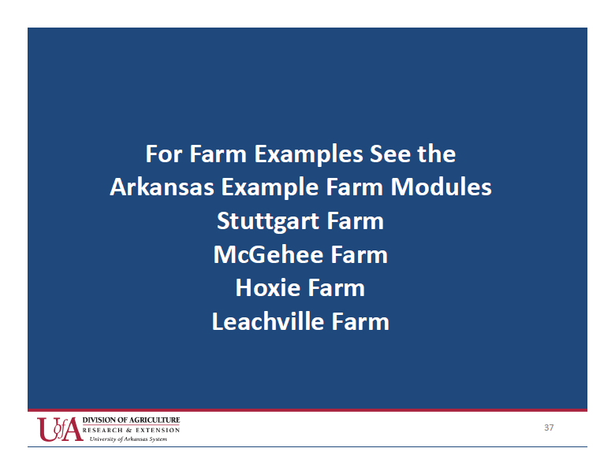
Farm Bill 2014 Overview and Introduction to Impacts
on Example Arkansas Farms
Eric J. Wailes and Eddie C. Chavez,
Dept. Agricultural Economics and Agribusiness, University of Arkansas

Slide 32
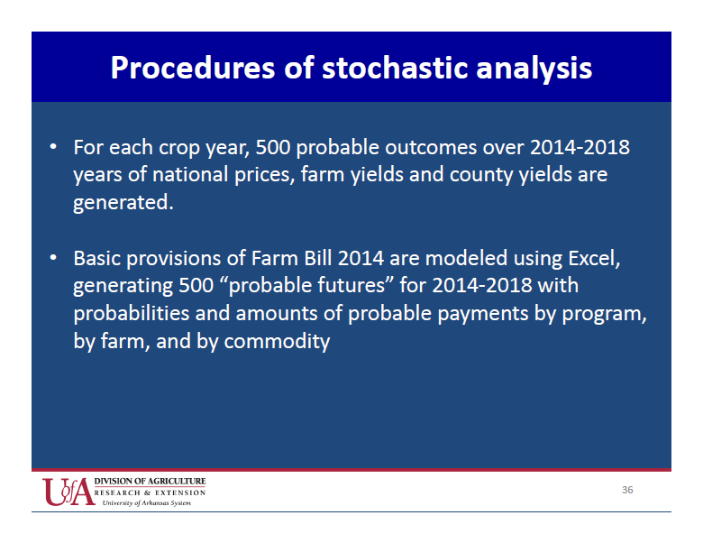
Eric J. Wailes and Eddie C. Chavez,
Dept. Agricultural Economics and Agribusiness, University of Arkansas

Slide 33
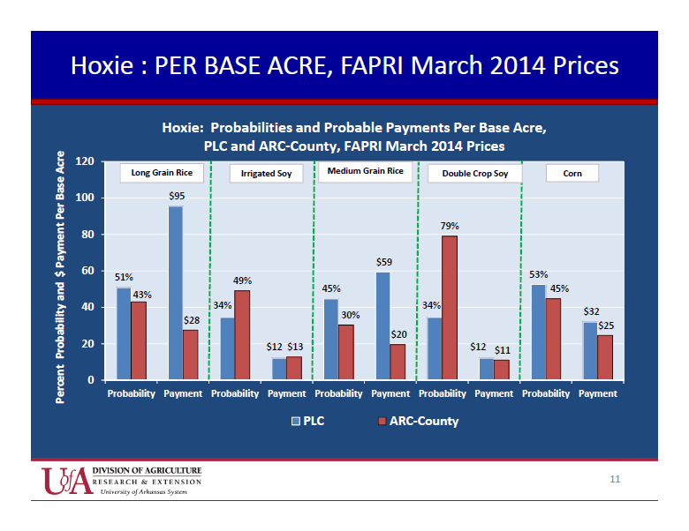
Eric J. Wailes and Eddie C. Chavez,
Dept. Agricultural Economics and Agribusiness, University of Arkansas

Slide 34
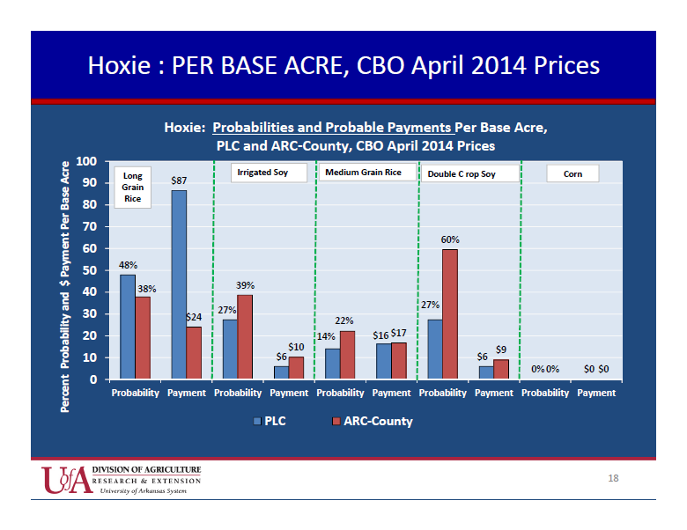
Eric J. Wailes and Eddie C. Chavez,
Dept. Agricultural Economics and Agribusiness, University of Arkansas

Slide 35
Conclusions
Program decision for peanuts and rice will be pretty straight forward for most cases. Other crops will be more complicated driven by price outlook and yields.
Options for reallocating base and updating yield will vary on farm by farm, case by case basis because of dynamics of landowner and tenant relationships and planting shifts.
Reallocation to more peanut and rice base in areas of increased acreage.
Growers will be looking for help in making decisions that have long term impact (life of farm bill).

Slide 36
Peanut Implications
Shifts in peanut acreage have occurred since 2002.
Base acreage and planted acres don’t line up in some states.
Peanuts are grown in rotation with cotton.
Growers will use Generic Base to manage price/revenue risk in low price years.
Long run, the boom-bust cycle of planting peanuts may moderate due to sticking to rotations.

Slide 37
Thank You
Acknowledgements:
John Michael Riley, University of Georgia
Archie Flanders, Eric J. Wailes, and Eddie C. Chavez, University of Arkansas

