Slide 1
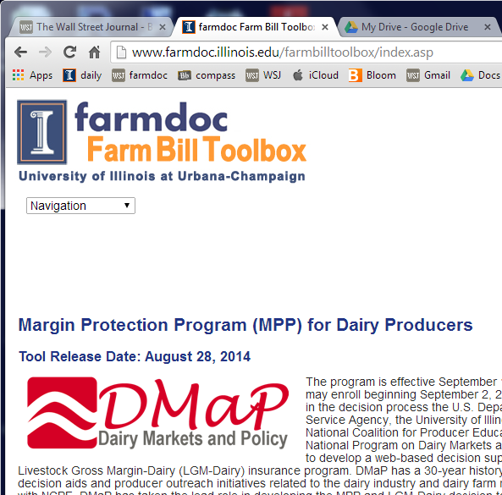
University of
Illinois
Consortium
Outreach
ARC / PLC
Dairy
NAP tool
www.farmdoc.illinois.edu/farmbilltoolbox

Slide 2
Partners
ARC / PLC
  University of Illinois
  Watts & Associates
  The Ohio State University
NAP
  Michigan State
Dairy
  Program on Dairy Markets (Cornel, MSU, Wisconsin, Illinois)
Outreach
  Delaware State
  University of Arkansas at Pine Bluff
  North Carolina Agricultural and Technical State University

Slide 3
Commodity Program Decisions
Each FSA farm:
Programs yields (current or updated)
Base acres (current or reallocated)
For each FSA farm/crop, which program will be used to make payments:
  Price Loss Coverage (PLC) – option to buy SCO
  Agriculture Risk Coverage – County level (ARC – County)
  Agriculture Risk Coverage – Individual level (ARC – Individual)
    * ARC-individual applies to all crops and all farms in a state
* SCO not available with ARC
Decision begin this fall on updating
Commodity program choice in winter

Slide 4
Steps for Each FSA Farm
(on Farmdoc website)
Collect information for each FSA farm
Determine to keep or update yields
Determine to keep or reallocate acres
Decide PLC or ARC-County for each crop
Will ARC-IC be considered?
Will SCO be considered (only if choose PLC)?
More info and iterate back
Complete forms / other issues
Green – Yield decision
Red – Acre update
Black – Program choice

Slide 5
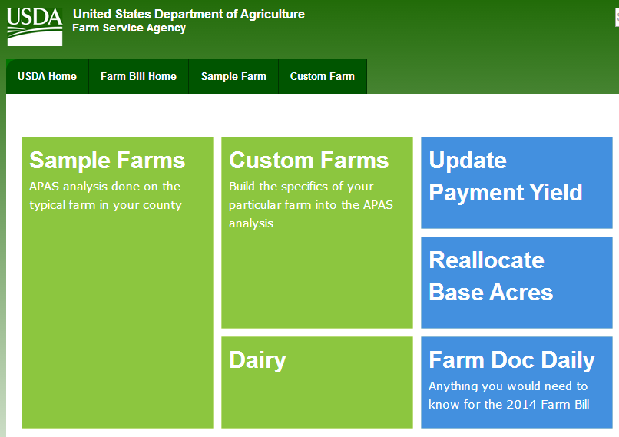

Slide 6
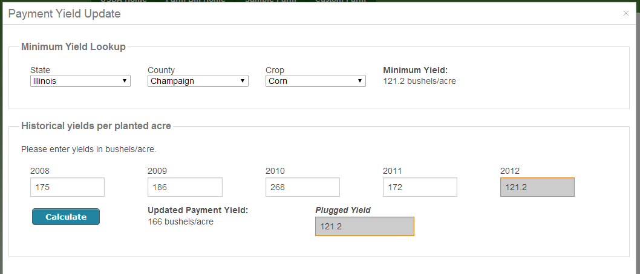
Update Yields

Slide 7
Determine to Keep or Update Yields
Crop by crop decision
Choice:
  Current Yield: (FSA letter) or
  Updated yield: 90% of 2008-2012 yields, plug yields for low yields
Choose highest yield
Only impacts PLC payments
Consider updating even if not use PLC, yields could “hang around”
Only reason not to choose highest is if its an updated yield and documentation is difficult to come by

Slide 8
Base Acre Updating

Slide 9
Keep or Reallocate Base Acres Across Crops
Choices: 1) Current base acres (letter from FSA)
2) Updated based on 2009 to 2012 plantings
(Does not change total base acres)
Pick allocation with most acres in corn

Slide 10
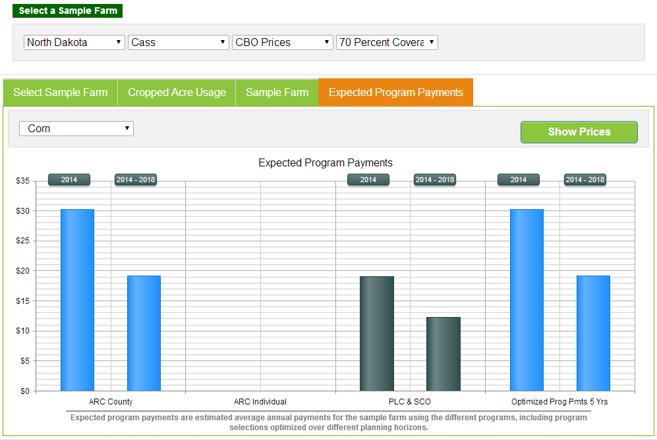

Slide 11
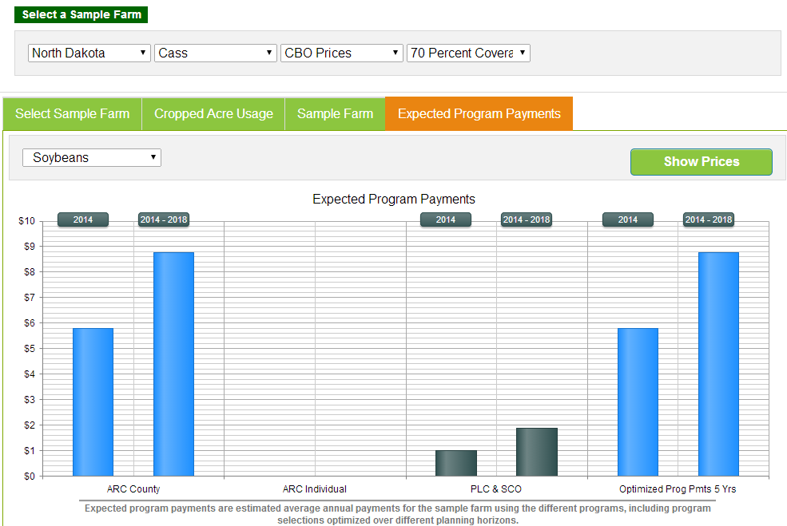

Slide 12
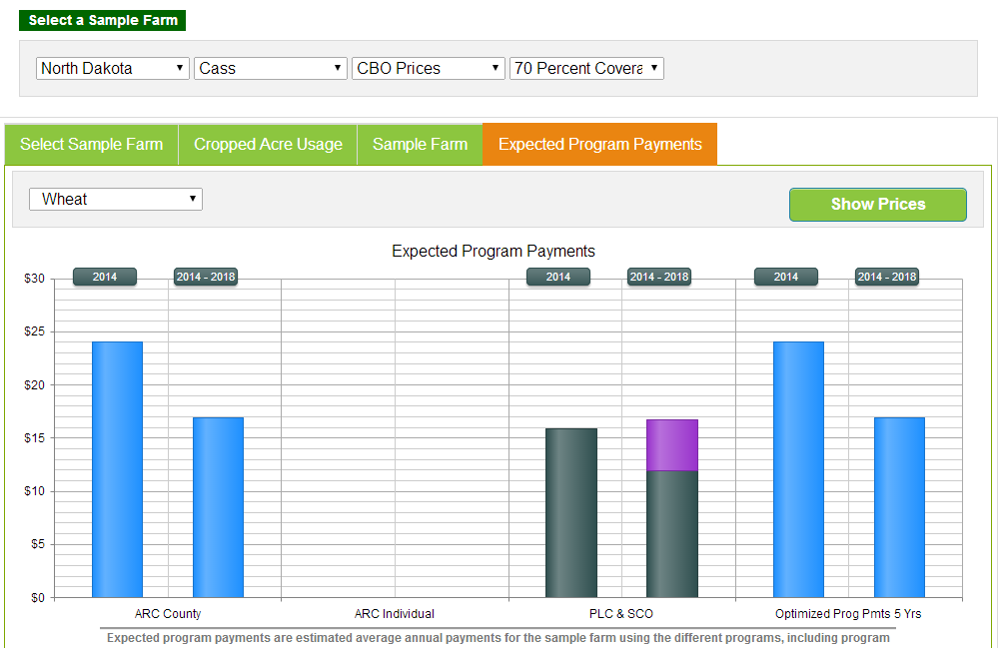

Slide 13
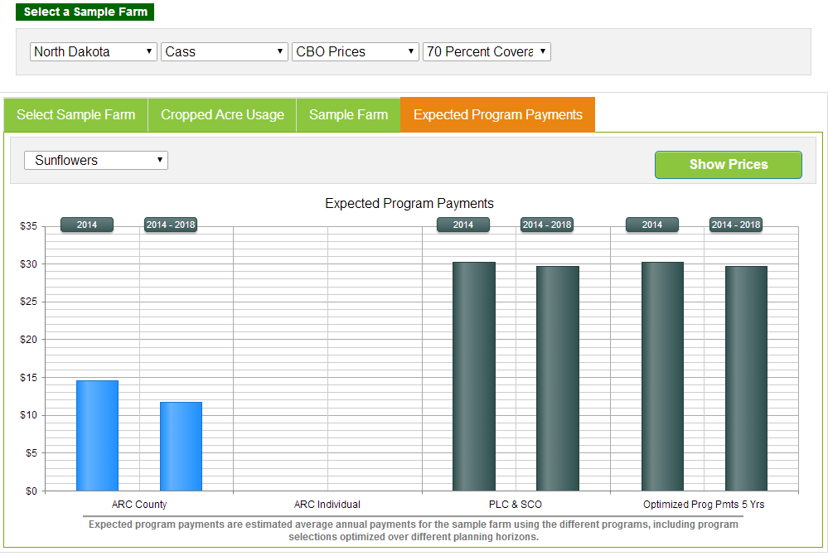

Slide 14
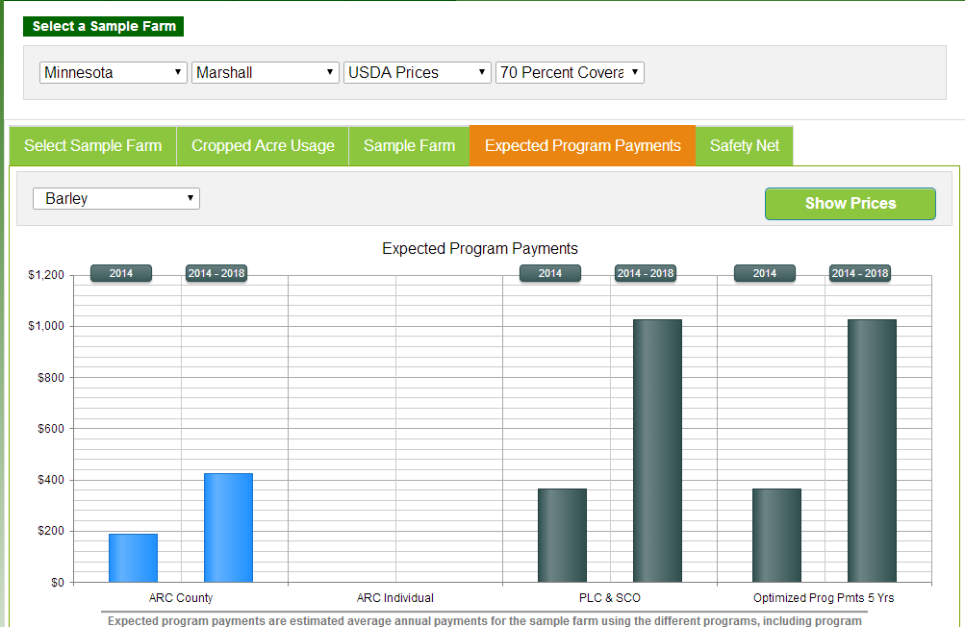

Slide 15
Program Decision
Three choices:
  PLC (Price Loss Coverage) – can have SCO
    Target price (now reference price) program
  ARC-County – can not have SCO
    Agricultural Risk Coverage
    County level revenue program
  ARC-IC – ARC individual – can not have SCO
    Farm Level revenue program
    All crops together in guarantee calculations
    Not be used much, explain why latter
Except for ARC-IC, all program by FSA farm/crop, ARC-IC is per farm

Slide 16
Suggestions for Program Decisions
Rank order expected payments
Know for each crop, break points between PLC / ARC – County

Slide 17
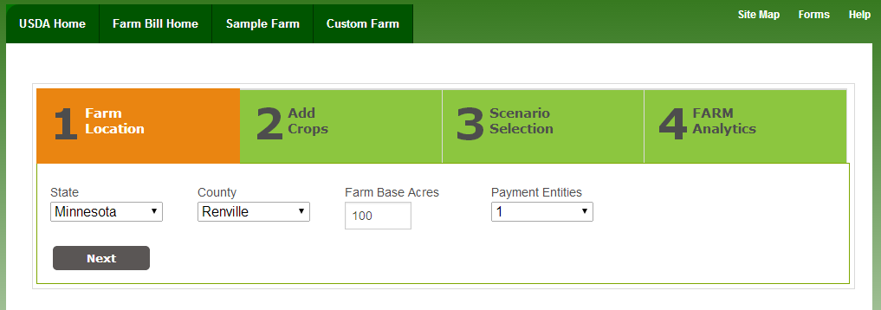

Slide 18
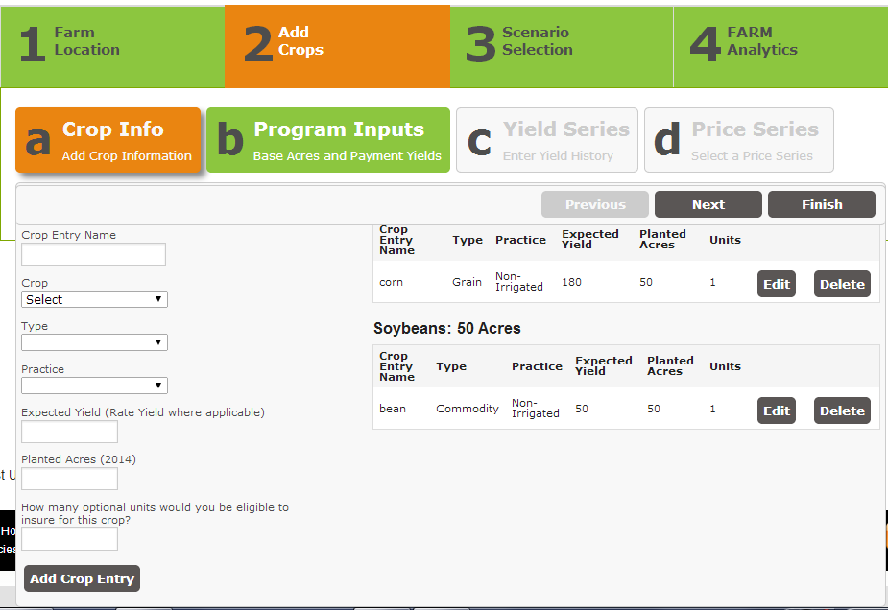

Slide 19
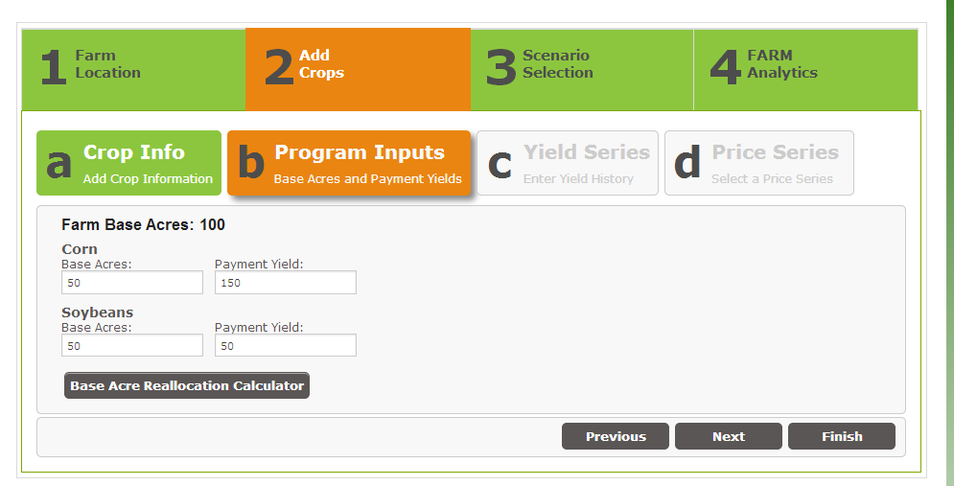

Slide 20
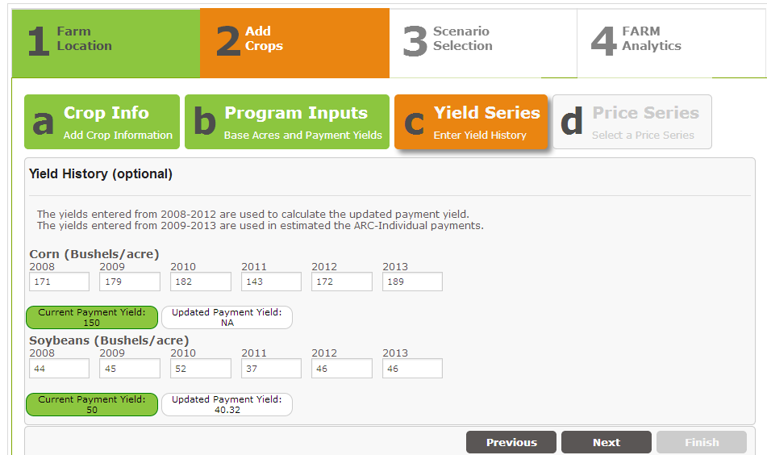

Slide 21
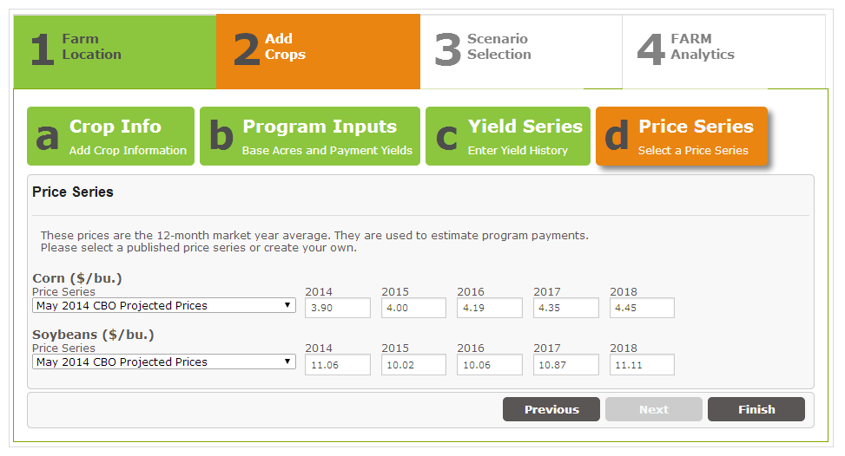

Slide 22
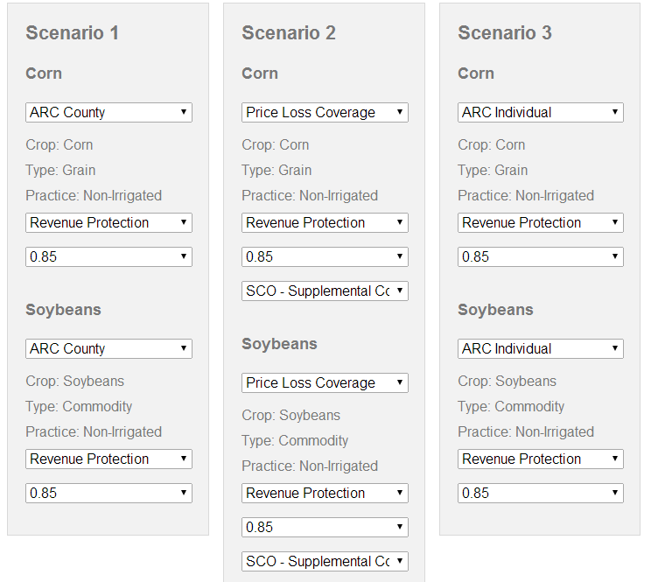

Slide 23
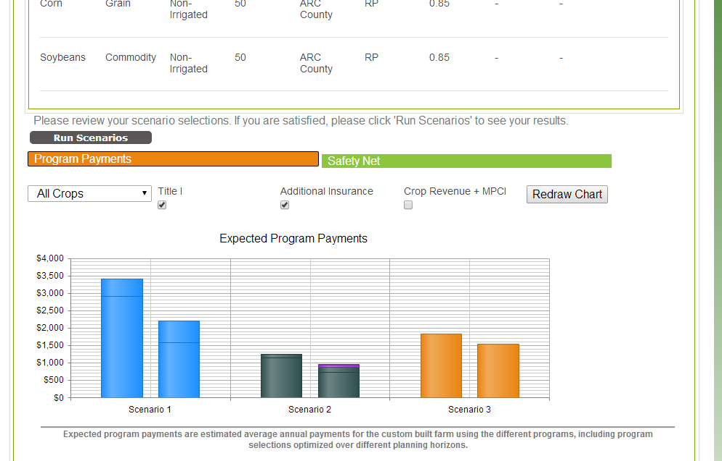

Slide 24
Thank you and Questions

Slide 25
Bonus Slides

Slide 26
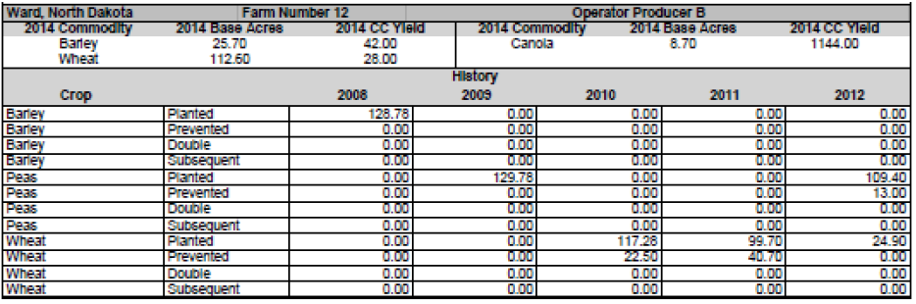
1. Collect Info for Each FSA Farm
From FSA (you should have received a letter for each farm with the following information)
  Base acres
  Program yields
  Planted acres
Other
  Yields from 2008 to 2012

Slide 27
2. Determine to Keep or Update Yields
Crop by crop decision
Choice:
  Current Yield: (FSA letter) or
  Updated yield: 90% of 2008-2012 yields, plug yields for low yields
Choose highest yield
Only impacts PLC payments
Consider updating even if not use PLC, yields could “hang around”
Only reason not to choose highest is if its an updated yield and documentation is difficult to come by

Slide 28
3. Decide: Keep or Reallocate Base Acres Across Crops
Choices: 1) Current base acres (letter from FSA)
2) Updated based on 2009 to 2012 plantings
(Does not change total base acres)
Pick allocation with most acres in corn

Slide 29
Example 1. Multiple years corn
Example 2. Alfalfa 2009 – 2011, corn in 2012
Example 3. Overplant base, same acres

Slide 30
Program Decision
Three choices:
  PLC (Price Loss Coverage) – can have SCO
    Target price (now reference price) program
  ARC-County – can not have SCO
    Agricultural Risk Coverage
    County level revenue program
  ARC-IC – ARC individual – can not have SCO
    Farm Level revenue program
    All crops together in guarantee calculations
    Not be used much, explain why latter
Except for ARC-IC, all program by FSA farm/crop, ARC-IC is per farm

Slide 31
Examples: 2 FSA farms, corn and soybeans each farm
Example 1
Example 3
Farm 1
Corn – ARC-County
Soybeans – PLC
Farm 2
Corn – ARC-County
Soybeans – PLC
Farm 1
Corn – ARC-County
Soybeans – ARC-County
Farm 2
ARC-IC – all crops
Example 2
Farm 1
Corn – ARC-County
Soybeans – ARC-County
Farm 2
Corn – ARC-County
Soybeans – PLC

Slide 32
Other Points
Payments are made on base acres, not planted acre for PLC and ARC-County.
Plantings matter under ARC-IC but payments made on total base acres
Farmers could easily make different decisions on each farm.

Slide 33
4. Decide ARC-County or PLC
ARC-County
PLC
ARC-County is a county revenue program – payments below a guarantee, guarantee is based on past 5 yields and Market-Year-Average prices
Given current benchmark prices , ARC-County likely to make larger payments than PLC
PLC is a target price program – payments are made when below a reference price
Reference Price:
Corn: $3.70
Soybeans: $8.40
Wheat: $5.50

Slide 34
McLean County, Corn, Example

Slide 36
Example of Expected 4-Year Payments

Slide 37
Break Points
Corn ($3.70 reference price)
  ARC-County make higher payments if MYA price averages above $3.30 (all five years)
Soybeans ($8.40 reference price)
  ARC-County higher payments > $7.80
Wheat ($5.50 reference price)
  ARC-County higher payments > $5.50

Slide 38
PLC / ARC-County
PLC is attractive if farmer believes (or is concerned about) low prices well below reference rates
ARC-County is attractive if lower prices, near or above reference prices
ARC-County for corn and soybeans likely to make higher payments, but be aware of disaster price risk

Slide 39
7. Enroll Farm in ARC-Individual
Not likely, why?
  Whole farm insurance (group all crops/FSA farms together)
  ARC-Individual pays on 65% of base acres, ARC-County and PLC on 85% of base acres
Maybe use ARC-Individual for one farm with extreme yields and one crop, but if you get two they will average together

Slide 40
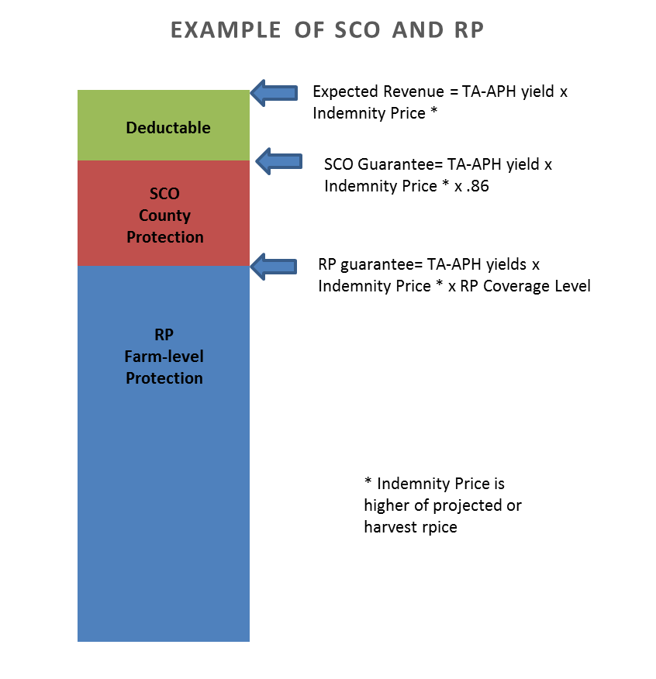
6. Will SCO be Considered
SCO is crop insurance, through crop insurance agent, not FSA, no FSA signup
Only available under PLC
Provide county triggered coverage from 86% to COMBO product coverage level

Slide 41
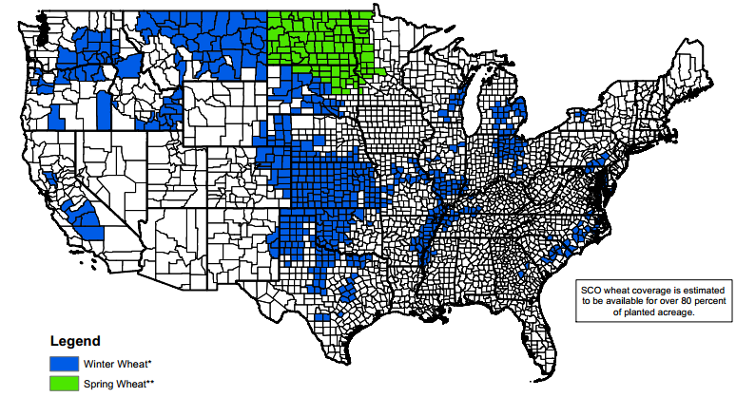
SCO eligibility
1. Do not select ARC as commodity program choice
Be in a county where SCO is offered (see map).
Select a COMBO product (RP, RPwExcl, YP)

Slide 42
3. Decide Whether SCO is an Alternative You Will Consider?
Observations:
If an 85% COMBO product is available, very little additional risk protection under SCO,
SCO+RP will have premiums mostly above 75% coverage level
SCO products may have higher returns than COMBO product. Picking SCO with RP-80% may have net payments (insurance payments – premiums) of $5 per acre more than RP-85%. Preliminary estimate need to see rates
Many Midwest farmers will be indifferent (not a big deal)

Slide 44
Premiums
My point:
Note how close RP + SCO premiums are to one another
Coverage Level | RP | SCO | RP + SCO
50% | 3.64 | 18.00 | 21.64
55% | 5.15 | 16.00 | 21.15
60% | 6.33 | 15.00 | 21.33
65% | 7.76 | 14.00 | 21.76
70% | 9.27 | 12.00 | 21.27
75% | 12.61 | 9.00 | 21.60
Enterprise unit (100 acres), Livingston County
$6.72 projected price, .21 volatility
55 APH yield, 60 TA-APH yield

Slide 45
Premiums
My point:
I would not go to low coverage levels, particularly on corn.
SCO at 70% and higher coverage levels is at or above RP 80% alone.
Coverage Level | RP | SCO | RP + SCO
50% | 1.73 | 7.00 | 8.73
55% | 2.33 | 7.00 | 9.33
60% | 3.14 | 7.00 | 10.14
65% | 4.20 | 7.00 | 11.20
70% | 5.28 | 7.00 | 12.28
75% | 7.50 | 6.00 | 13.50
80% | 12.52 | 4.00 | 16.52
85% | 22.16 | 1.00 | 23.16
Enterprise unit (100 acres), Henry County, Ohio
$6.72 projected price, .21 volatility

Slide 46
ARC-Individual Example

Slide 47
ARC – Individual
ARC – Individual is best thought of as whole-farm insurance, payments are calculated based on whole-farm revenue
Rates are calculated across all FSA farms enrolled in ARC – Individual
Planted acres determine weights in benchmark revenue
Payments are made on base acres x .65

Slide 48
ARC – Individual
ARC-Individual will make payments when a farm’s actual revenue falls below .86 times benchmark revenue
Actual revenue equals sum of each crops’ revenue (National Market Year Average price x farm yield) weighted based on planted acres
Benchmark revenue equals sum of each crops’ benchmark weighted based on planted acres.

Slide 49
ARC – Individual
2014 Example
The following example shows a 2014 payment for one FSA farm with 100 total base acres. In this example, no other farms are enrolled in ARC – Individual
In 2014, the farm plants:
60% of acres in corn
40% of acres in soybeans

Slide 50
ARC -- Individual
Each Crop’s Benchmark Revenue
 | Corn |  |  | Soybeans
Year | Price | Farm Yield | Revenue¹ | Price | Farm Yield | Revenue¹
2009 | 3.55 | 186 | 688 | 9.59 | 54 | 518
2010 | 5.18 | 170 | 881 | 11.30 | 59 | 667
2011 | 6.22 | 160 | 995 | 12.50 | 56 | 700
2012 | 6.89 | 110 | 758 | 14.40 | 52 | 749
2013 | 4.50 | 190 | 855 | 12.50 | 54 | 675
¹Revenue equals maximum of national market year average price or reference price ($3.70 for corn, $8.40 for soybeans) times farm yield
Each crop’s benchmark revenue equals Olympic average of revenues:
Corn: $831 = ($881 + $758 + $855) / 3
Soybeans: $681 = ($667 + $700 + $675) / 3

Slide 51
ARC -- Individual
Benchmark Revenue and Guarantee
Benchmark Revenue weights each crop’s benchmark revenue by proportion of program crop acres planted on ARC-Individual farms
Corn Soybeans
$771 = $831 x .60 + $681 x .40
Guarantee is .86 x benchmark revenue:
$663 = .86 x $771 benchmark revenue

Slide 52
ARC – Individual
2014 Revenue
A farm’s revenue equals each crop’s revenue weighted by proportion of acres:
$3.75 MYA corn price
185 bushel per acre corn yield
$11 MYA soybean price
50 bushel per acre soybean yield
$636 = .6 x ($3.75 x 185) + .4 x ($11 x 50)

Slide 53
ARC – Individual
Payment Rate
Payment rate equals ARC guarantee minus revenue
$27 Rate = $663 Guarantee - $636 Revenue
Rate can not be less than one.
Rate can not be more than 10% of benchmark revenue ($77 = .10 x $771).

Slide 54
ARC – Individual
Payment
Payment equals payment rate x base acres x .65 (payment acres are 65% of total base acres)
$27 payment rate
100 base acres
$1,755 = $27 payment rate x .65 x 100 acres

