Slide 1







Margin Protection Program (MPP) ONLINE DECISION T L
John Newton
University of Illinois
jcnewt@illinois.edu
@New10_AgEcon

Slide 2

USDA Dairy Costs of Production
Total Costs
Total, Gross Value of Production
Total costs include operating costs and over head costs such as labor, taxes, and insurance.
Based on USDA survey data the costs of producing milk have outstripped the milk price received.
Source: USDA Economic Research Service Survey Data

Slide 3
Income Over Feed Costs
Margin = U.S. All-Milk Price – NASS Corn Price x 1.0728 + AMS SBM x 0.00735 + NASS Alfalfa x 0.0137
2010
Secretary’s Dairy Advsy C’mte Recommends Margin Insurance
May 2011
Senate First Hearing on Farm Bill
2014 Farm Bill Dairy Production Margin
June 2009
$2.25/hundredweight
Source: USDA National Agricultural Statistics Service and Agricultural Marketing Service

Slide 4
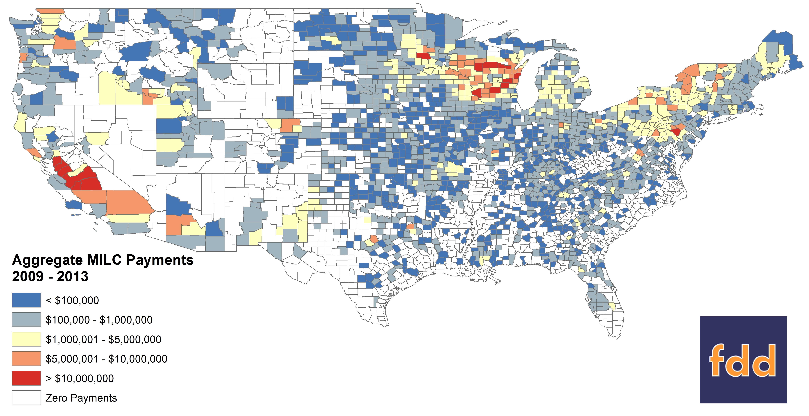
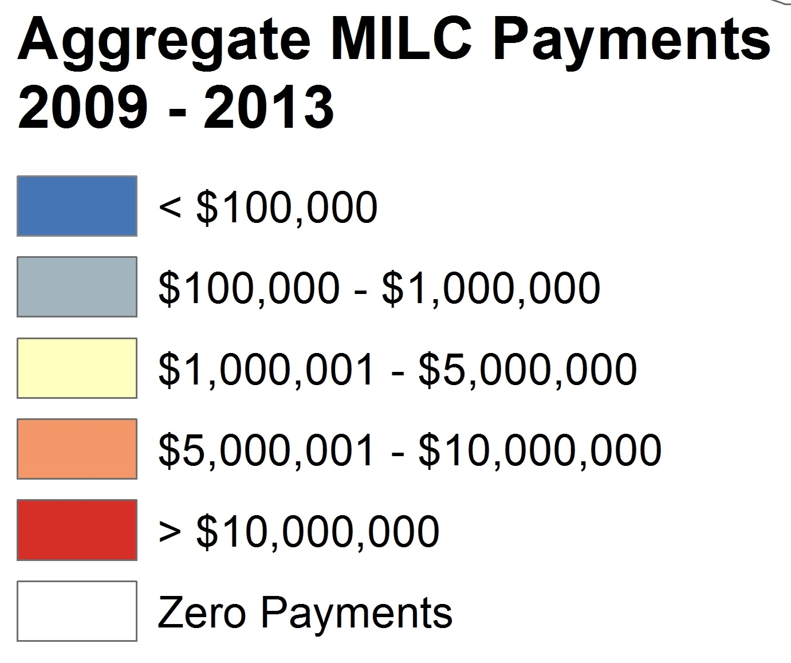
Did Dairy Have a Safety Net? Milk Income Loss Contract (MILC)
MILC 2009+ Covered 185 Bil Lbs and paid $1.6 billion to 47K farmers ($0.86/cwt)
2.985 Million Pound Benefit Cap

Slide 5
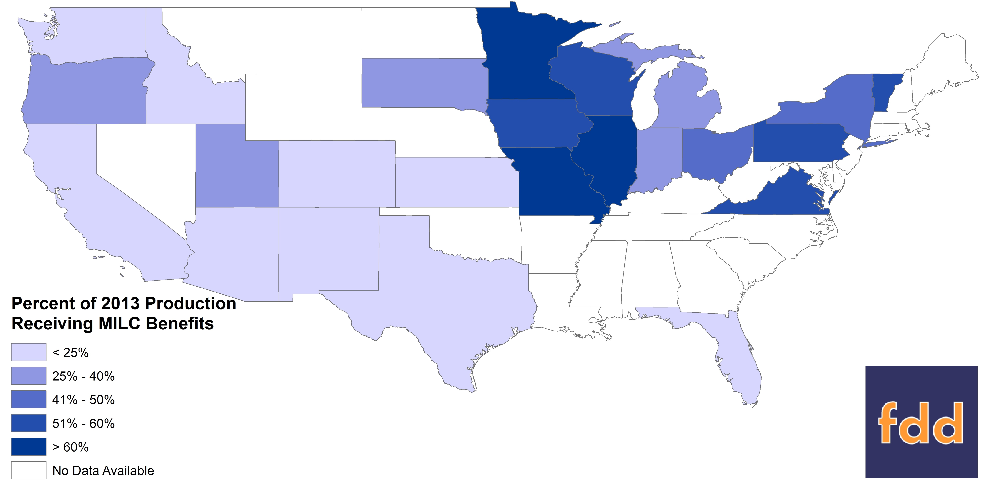
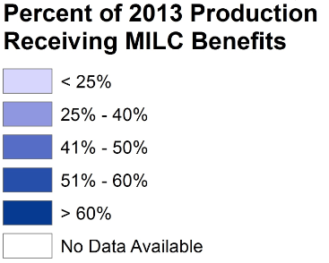
Benefit Concentration in MILC
42% of US Milk Supply Covered by MILC

Slide 6
MPP: How it Works
Voluntary program designed to protect dairymen from downturns in the dairy margin
Makes payments when US dairy margin falls below the farmer-selected coverage option
Price floors available from $4 to $8 hundredweight
Can cover 25% to 90% of production
Farm operators pay $100 administrative fee and premiums based on farmer-selected coverage
Consecutive 2-month average margins determine indemnity: Jan/Feb, …, Nov/Dec
No eligibility constraints (income or production)
Decision by End of Nov (2014/15) Sept (2015+)

Slide 7
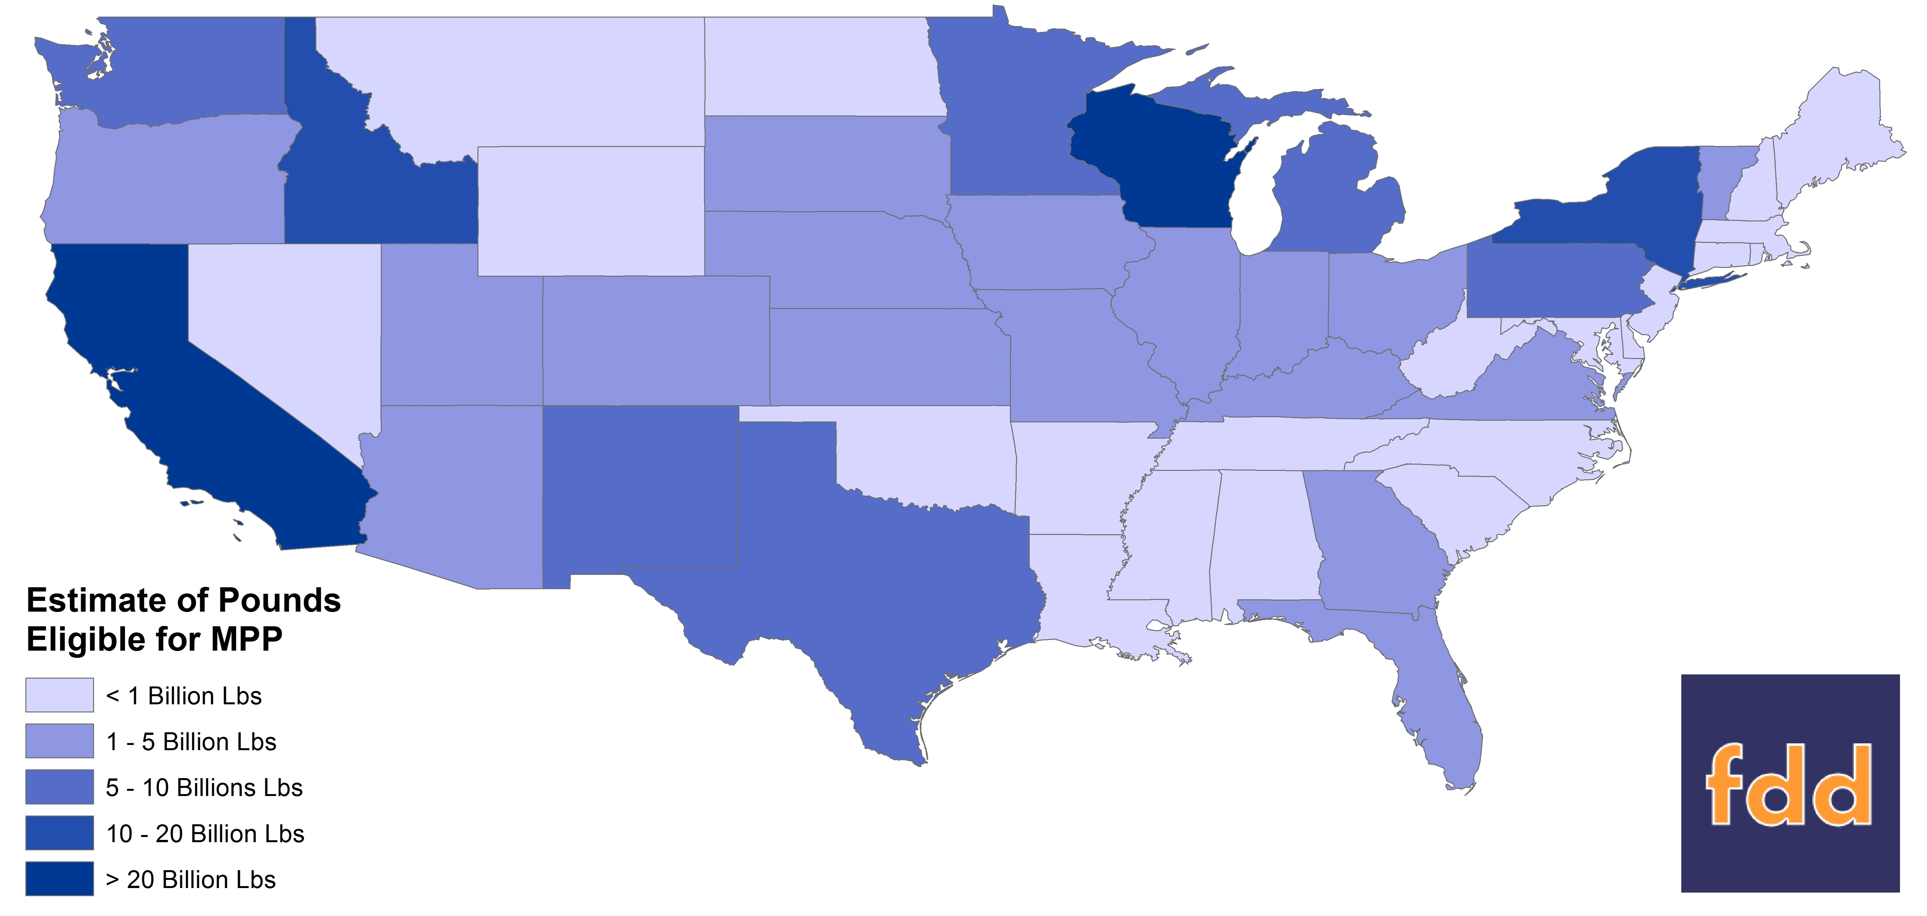
Margin Protection Program (MPP) as the Replacement
Farms Can Cover:
Max(2011,2012,2013) Milk Lbs.
182 Billion Lbs

Slide 8
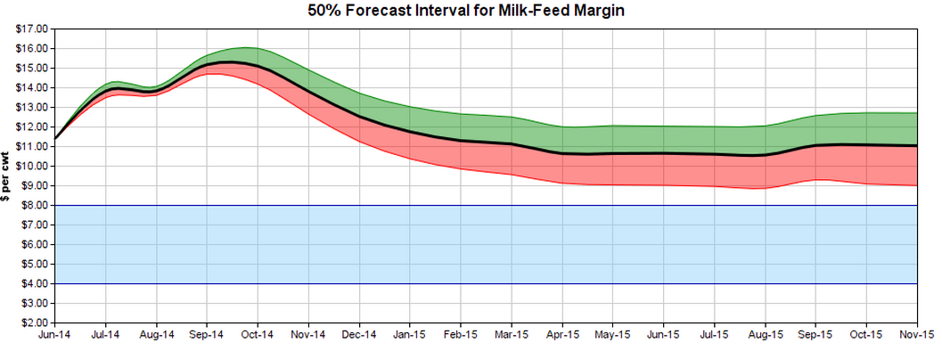
MPP: A New Way to Think About a Government Safety Net
Key farmers decisions:
How much milk to protect (25% to 90%)
What margin level to protect ($4 to $8)

Slide 9
Coverage Options*
Greater Protection at a greater cost
*126 Possible Coverage Choice Combinations

Slide 10
Premium Rates May Alter Participation Incentives
$6.50 to $7.00 coverage has $0.54 increase in Tier 2 premium
FREE
Tier 1: First 4MM #s / Tier s: After 4MM #s

Slide 11

MPP: USDA Funded Producer Decision Education Project
Margin Protection Program (MPP) ONLINE DECISION T L
Including the LGM-Dairy Analyzer ©
8 Extension Economists
----
7 Land Grant Institutions

Slide 12

Easy Cross-Program Comparison
ONE CLICK
Switch between the MPP-Dairy Tool & the “Award Winning” LGM-Dairy Analyzer ©

Slide 13
Built With Farmers in Mind
Only one data point needed Farm’s Milk Production History

Slide 14
4 Steps of the Decision Tool

Slide 15
Windows PC, iOS, & Android
All calculations are performed in the cloud to maximize efficiency.

Slide 16

Advanced Users
Name Your Own Prices Milk & Feed Price Customization

Slide 17


Secure and 100% Free
100% Free
DATA SECURITY
24/7 Access
Farmer Data is Not Collected
Always Available & Free to Use

Slide 18

Online Educational Material
Find videos, PowerPoints, printed material, and links to other Farm Bill decision tools online.
www.dairymarkets.org/MPP

Slide 19
Margin Protection Program (MPP) ONLINE DECISION T L
Demonstration

Slide 20
Government Tools Available to Help Dairy Farmers Manage Risk
LGM-Dairy
USDA Risk Mgmt Agency
Authorized in 2008
MPP-Dairy
USDA Farm Service Agency
Authorized in 2014
Dairy farmers may participate in the new MPP program or LGM-Dairy but not both.

Slide 21
Reviewing MPP and LGM-D
Philosophically Different Approaches
Target Deficiency Payment Program
Futures & Options Based Risk Management
Margin Protection Program
Provides protection against multi-year losses from $4 to $8 cwt
Is not actuarially fair and is not based on milk and feed market prices (“Cost Sharing”)
Indemnity payments only when margin falls below user selected coverage level
No payment limitations or AGI caps on eligibility
LGM-Dairy
Protects average gross margin at prevailing market prices, price floor moves up or down
Is designed to be actuarially fair pre-subsidy (includes deductible)
Indemnity payments when actual margins are below guarantee at end of coverage period
Lacks sufficient underwriting capacity for continuous coverage

Slide 22
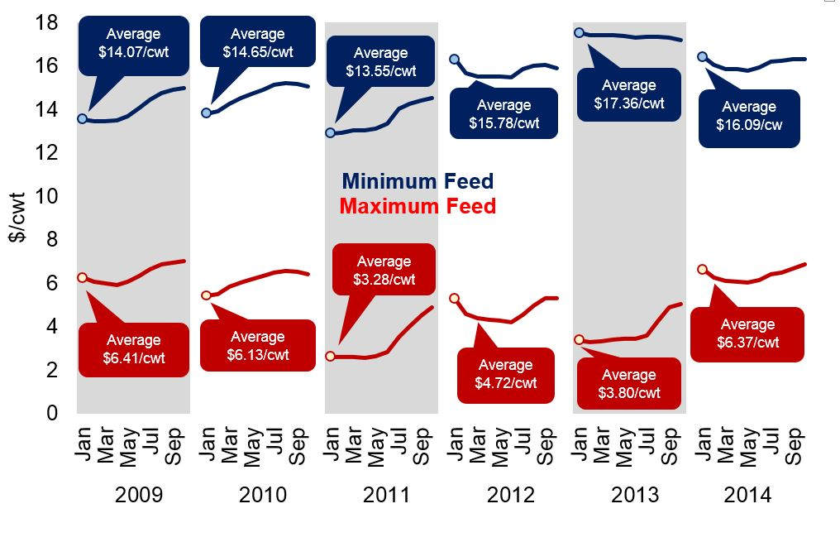
Available Price Floors Using LGM-Dairy Nov PY Purchase Date (10-Month Contract)
MPP Coverage

Slide 23
LGM-Dairy Uses Futures Prices Guaranteed Price Floor Using LGM-Dairy Nov PY Purchase Date (10-Mo Contract)*
MPP Coverage
Average $7.46/cwt
Average $5.93/cwt
Average $5.43/cwt
Average $4.58/cwt
Average $7.91/cwt
Average $7.32/cwt
*Equivalent MPP Ration

Slide 24
LGM-Dairy Summary Statistics
Reinsurance Year | Premium ($M) | Indemnity ($M) | Net Benefit ($M)
2009 | 0.29 | 0.72 | 0.43
2010 | 0.78 | 0.28 | -0.50
2011 | 25.01 | 0.07 | -24.94
2012 | 19.18 | 1.39 | -17.79
2013 | 16.87 | 2.63 | -14.24
2014 | 11.64 | 0* | ????
Total | 73.77 | 5.09 | -57.04*
* As of 7/29/2014
Source: USDA Risk Management Agency

Slide 25
Survey of LGM and MPP Participation
If you had to make a one-time, permanent choice between the Margin Protection Program and Livestock Gross Margin Insurance for Dairy Cattle?
Source: Bozic, 2014

Slide 26
Payment Frequency MILC and MPP
“Catastrophic Coverage”

Slide 27
MPP: Dairy Margin Index
IOFC Margin = U.S. All-Milk Price – NASS Corn Price x 1.0728 + AMS SBM x 0.00735 + NASS Alfalfa x 0.0137
Source: USDA National Agricultural Statistics Service and Agricultural Marketing Service

