Slide 1


Impacts on the Livestock Sector
2014 Farm Bill Education Conference
Kansas City, Missouri
September 4, 2014
David P. Anderson
Professor and Extension Economist

Slide 2
Overview
LFP, LIP, etc.
COOL
Spillover Effects
And a Few Others
Policy

Slide 3
Livestock Title
The Old Farm Bill Had a Livestock Title
But, It Was So Controversial There Isn’t One Now
  So now we have livestock stuff

Slide 4
Livestock Forage Program (LFP)
The Agricultural Act of 2014 (2014 Farm Bill) makes LFP permanent
Provides retroactive authority to cover eligible losses back to October 1, 2011 – Eliminated NAP requirement
Compensation to eligible livestock producers suffering grazing losses for covered livestock on land that is native or improved pastureland with permanent vegetative cover or is planted specifically for grazing
The grazing losses must be due to a qualifying drought condition during the normal grazing period for the county

Slide 5
To be eligible for LFP, producers must:
Own, cash or share lease, or be a contract grower of covered livestock during the 60 calendar days before the beginning date of a qualifying drought or fire;
Provide pastureland or grazing land for covered livestock, including cash-rented pastureland or grazing land that is either:
  Physically located in a county affected by a qualifying drought during the normal grazing period for the county, or;
  Rangeland managed by a federal agency.
Certify that they have suffered a grazing loss because of a qualifying drought or fire;
Timely file an acreage report for all grazing land for which a loss of grazing is being claimed.

Slide 6
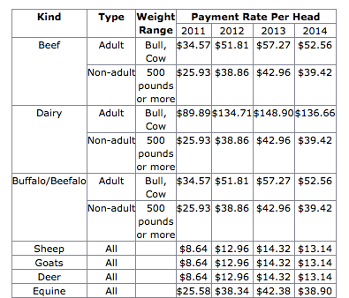
Eligible Livestock

Slide 7
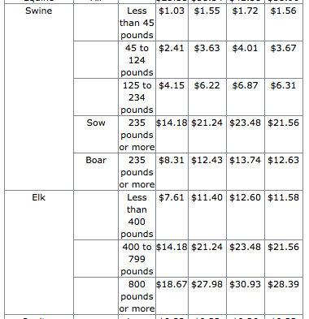
Eligible Livestock

Slide 8
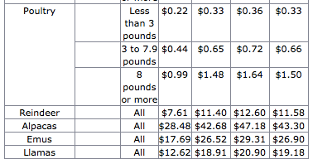
Eligible Livestock

Slide 9
Payment Calculation
FSA will calculate LFP payments for an eligible livestock producer at 1, 3, 4, or 5 times the monthly payment rate.
The LFP monthly payment rate for drought is equal to 60 percent of the lesser of the monthly feed cost:
  For all covered livestock owned or leased by the eligible livestock producer; or
  Calculated by using the normal carrying capacity of the eligible grazing land of the eligible livestock producer.
Total LFP payments will not exceed five monthly payments for the same livestock.

Slide 10
Payment Calculation
(Mitigated Livestock)
In the case of an eligible livestock producer who sold or otherwise disposed of livestock because of drought conditions in one or both of the two previous production years immediately preceding the current production year, the payment rate will equal 80 percent of the monthly payment rate.

Slide 13
Eligible Counties due to Drought
Drought Threshold | Weeks Required in Threshold | Monthly Payments
D2 | 8 | 1
D3 | Any | 3
D3 | 4 | 4
D4 | Any | 4
D4 | 4 | 5

Slide 14
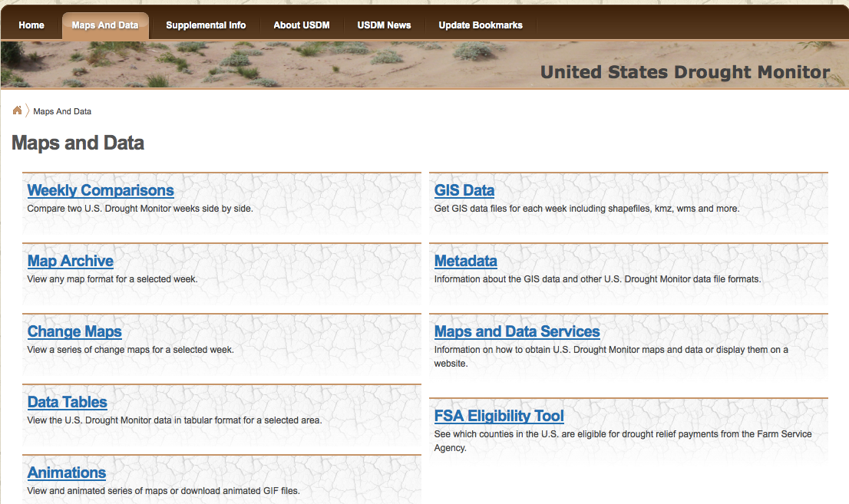
Checking County Eligibility

Slide 15
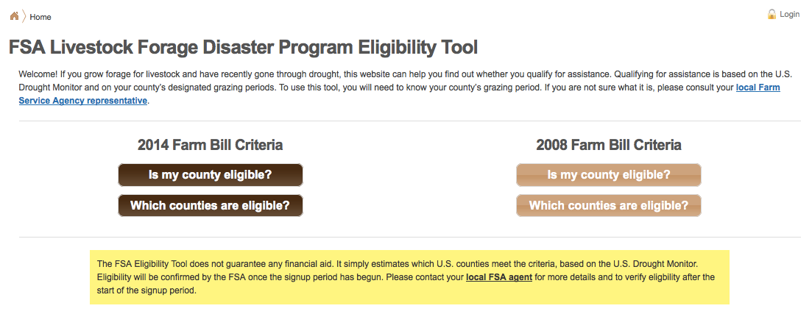
Checking County Eligibility

Slide 16
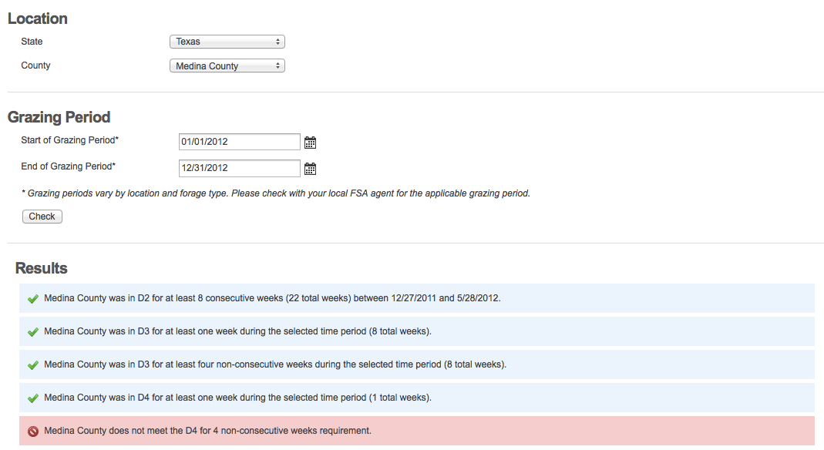
Checking County Eligibility

Slide 17
Payment Limitation
For 2012 and subsequent program years, payment limitation of $125,000 in payments under LFP, ELAP, and LIP combined.
For 2011, payment limitation $125,000 in payments under the LFP, ELAP, LIP, and Supplemental Revenue Assistance (SURE) payments program, when at least $25,000 of such total 2011 program payments is from LFP or LIP, for losses from October 1, 2011 through December 31, 2011.
Ineligible if the individual’s (or legal entity) average AGI exceeds $900,000.

Slide 18
Sign-up
Sign-up started April 15, 2014 and ends January 31, 2015 for grazing losses that occurred between October 1, 2011 through December 31, 2014.
For 2015 and subsequent calendar years, producers must provide a completed application within 30 calendar days after the end of the calendar year in which the grazing loss occurred.
  Important for ongoing education to remind signup

Slide 19
Issues
Used NRCS Stocking Rates
  Some have complained that those aren’t correct for their ranch
  Does not account for reduced calving rates next year or other impacts
  Drought Monitor used as trigger
Attempt to Get Relief to Livestock Producers Hit by Drought and Other Disasters
  Some money to help offset financial impact

Slide 20
Bottom Line
Run! Do Not Walk to Your FSA Office to Sign Up
  Or call them to set up appointment
It Is Subject to Reduced Payouts After October 1st
  But, my understanding is that a scheduled appointment prior to that date will count as prior to Oct. 1

Slide 21
Livestock Indemnity Program (LIP)
FY 2012 and each succeeding year
For livestock death in excess of normal mortality due to attacks by animals reintroduced into the wild by the Federal government, adverse weather (hurricanes, floods, blizzards, disease, wildfires, extreme heat, and extreme cold)
  Payment rates – 75% of the market value of applicable livestock

Slide 22
Environmental Quality Incentives Program (EQIP)
Merges Wildlife Incentive Program (WHIP) with EQIP
  Eligible lands include:
    Upland wildlife habitat
    Wetland wildlife habitat
    Habitat for threatened or endandered species
    Fish habitat
    Habitat on pivot corners and irregular areas of a field
    And as determined by the Secretary
60 Percent of Funding for Livestock Producers
At Least 5 Percent of Funds Targeted at Wildlife Benefitting Practices

Slide 23
Country of Origin Label (COOL)
2002 Farm Bill
Implemented in 2008
Remains Very Contentious
Appellate Court Just Ruled Against Groups Seeking to Eliminate COOL

Slide 24
Country of Origin Label (COOL)
WTO
  U.S. lost first round, USDA re-wrote rules
  WTO second round has been sent to involved countries, but it is not yet public
  WSJ article last week reported that the ruling is against the U.S.
  Wait and see
  Recourse?
List of Retaliation Products Announced by Canada

Slide 25
Spillover Effects
Farm Programs on Livestock
Risk Management Aids Crop Farmers
  Reduce uncertainty, aid planning
Indirectly, Good for Livestock Producers
Continue to Fight Through the Appropriations Process the Funding for Some GIPSA Rules That Came Out of the Last Farm Bill

Slide 26
Other Issues
Many More Outside the Farm Bill Than In It
  Endangered species, land use, immigration, etc.
Ethanol
  Biggest Policy Impact on Livestock and Dairy Producers, And it Wasn’t in the Farm Bill
Mandatory Price Reporting Re-Authorization
Production Process Requirements
  Whether government required or by others

