Slide 1
Trade Programs, Policies, and Outlook
2014 Farm Bill Education Conference
Luis A. Ribera
Associate Professor and Extension Economist

Slide 2
Outline
2014 Farm Bill Title III, Trade
U.S. Agricultural Trade Trends
Importance of TTIP and TPP FTAs
Growth trends

Slide 3
2014 Farm Bill, Trade
Reauthorizes all international food aid programs, including largest, Food for Peace Title II (Emergency and nonemergency food aid)
F4P to improve nutritional quality of food aid and not disrupt local markets
Repeals the annual amount “safe box” for targets: not less than 20% and no more than 30% for nonemergency food aid with minimum of $350 million
Reauthorizes the CCC and three export market promotion programs

Slide 4
2014 Farm Bill, Trade
Value of U.S. ag. exports to benefit from export credit guarantees remains at $5.5 billion
Gives flexibility to the Secretary of Ag. to make changes to the export credit guarantees to meet terms with Brazil on the WTO cotton case
$200 million for Market Access Program and $34.5 million for Foreign Market Development Program
Provision to reorganize international trade functions under new Undersecretary
Notes:
They include the Foreign Agricultural Service (FAS), Animal and Plant Health Inspection Service (APHIS), Food Safety and Inspection Service (FSIS) and Agricultural Marketing Service (AMS).
Under the current structure, FAS reports to the undersecretary for farm and foreign agricultural services, Michael Scuse. APHIS and AMS report to the undersecretary for marketing and regulatory programs, Ed Avalos, while FSIS reports to the acting undersecretary for food safety, Brian Ronholm

Slide 5
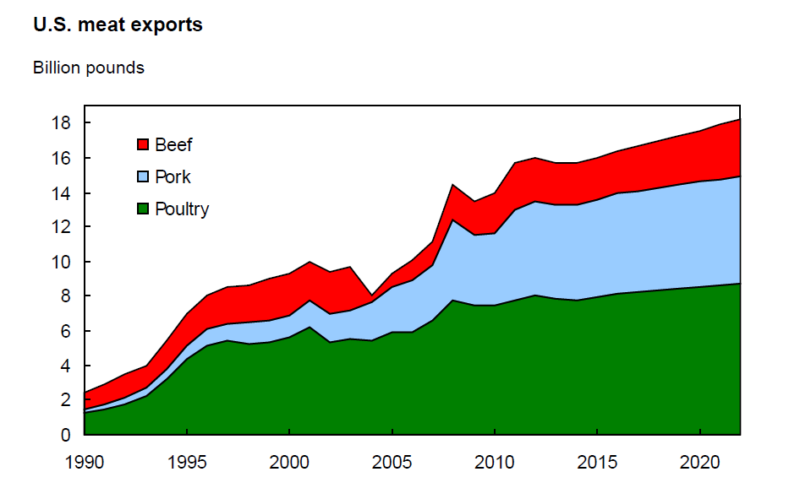
Global Markets
Are Important
For Most US Commodities
Source: Mickey Paggi, CSU-Fresno

Slide 6
U.S. Trade
The United States has been Engaged in Negotiating Multilateral, Bilateral and Regional free trade agreements (FTAs) since the 1960s.
The US signed pacts with Israel and Canada in the 1980’s.
In 1994, the Canadian-U.S. accord expanded to include Mexico, creating the North American Free Trade Agreement (NAFTA).
Twelve other FTAs with 17 countries followed, each providing additional opportunities for the U.S. economy and the agricultural sector.

Slide 7
U.S. Trade
2014 Farm Bill provision to reorganize international trade functions under new Undersecretary
Backed by major farm groups
Exports have increased from $29 billion in 1978 to $141 billion in 2013

Slide 8
U.S. Agricultural Exports by Region
Total $141 Billion FY 2013
$1.3 bil
$21.4 bil
$11.5 bil
$23.5 bil
$12.4 bil
$2.8 bil
$6.3 bil
$17.9 bil
$2.6 bil
$10.3 bil
$7 bil
$1.9 bil

Slide 9
U.S. Trade
TPP and TTIP negotiations are now the main trade policy focus of the Obama Administration
They are the two most important preferential trade agreements to be negotiated since NAFTA
Our TPP partners encompass a market of almost 500 million consumers with a combined GDP of almost $12 trillion. Partner Countries include: Canada, Australia, Mexico, Malaysia, Singapore, Chile, Peru, New Zealand, Vietnam, Brunei, and Japan
The TTIP with the EU spans 28 countries containing over 500 million consumers and a GDP of $16.5 trillion.

Slide 10
Why TTIP?
5 million EU jobs are supported by exports to the U.S.
Transatlantic trade represented 30% of global GDP in 2012.
U.S. exported $9.9 billion in agricultural products to the EU in 2012
Supporting about 68,000 jobs.
62% of U.S. Foreign Direct Investment comes directly from the EU. U.S.-EU investments in each others’ economies reached $3.7 trillion in 2011.
Source: http://useu.usmission.gov/index.html

Slide 11
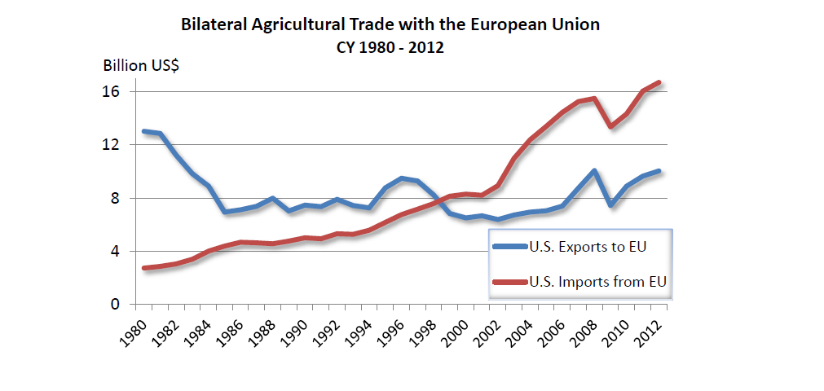
TTIP May Help US Ag Trade Balance

Slide 12
What Might Kill the Deal?
Food safety (Beef Hormone etc.)
GMO imports and cultivation
Are Considered non-negotiable areas in view of upcoming EU-US free trade talks, the French stressed.

Slide 13
Why TTP ?
The GDP of TPP-12 is $27.6 trillion, close to 40% of world economy and one-third of world trade
Population is 800 million
Total U.S. trade with TPP is $1.5 trillion in merchandise trade and $242 billion in services
TPP will upgrade existing trade agreements
Source: Colin A. Carter, UC-Davis

Slide 14
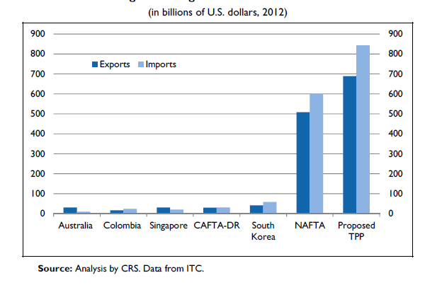
US Trade Under FTA’s
TPP has Potential to be the Largest

Slide 15
U.S. Agricultural Exports by Region
Total $141 Billion FY 2013
$1.3 bil
$21.4 bil
$11.5 bil
$23.5 bil
$12.4 bil
$2.8 bil
$6.3 bil
$17.9 bil
$2.6 bil
$10.3 bil
$7 bil
$1.9 bil

Slide 16
Developing Countries Dominate World Consumption and Import Growth, 2013-22
 | Share of projected growth
 | Consumption | Imports
 | Percent
Cotton | 95.1 | 99.8
Meats | 81.2 | 92.3
Beef | 80.0 | 77.5
Pork | 86.8 | 103.0*
Poultry | 77.2 | 99.7
* Indicates that the level for developed countries is projected to decline. Source: USDA, Economic Research Service using USDA Agricultural Projections to 2022 and supporting data.

Slide 17
Developing Countries Dominate World Consumption and Import Growth, 2013-22
 | Share of projected growth
 | Consumption | Imports
 | Percent
Grains | 87.9 | 94.0
Wheat | 81.1 | 92.8
Rice | 99.6 | 97.9
Corn | 82.4 | 93.7
Sorghum | 117.1* | 365.0*
Barley | 56.7 | 91.7
* Indicates that the level for developed countries is projected to decline. Source: USDA, Economic Research Service using USDA Agricultural Projections to 2022 and supporting data.

Slide 18
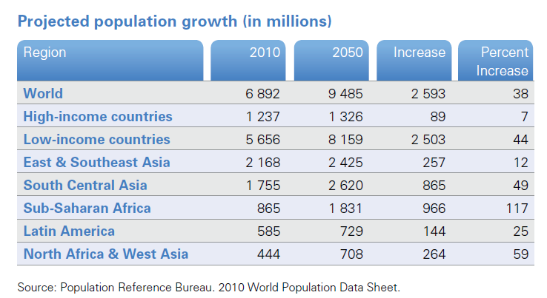
It is Where the Increase in Population
Will Occur

Slide 20
Conclusions
Little change from previous Bill
Globalization through FTAs are in full speed so the US need to be engaged
Lots of opportunities and challenges, issues with japan on tariffs, GMOs issues with EU, etc.
Trade opportunities with developing countries
Trade agreements promote economic well being economic stability promotes political stability

Slide 21
Thank you…

