Slide 1
Reading the Lines,
In Between the Lines, and Nowhere Near the Lines
Legal Issues in Environmental Contracting
Rodney Jones, Ph.D.
OSU Area Extension
Agricultural Economics Specialist
Shannon L. Ferrell, Esq., J.D.
OSU Dept. of Agricultural Economics
Asst. Prof. of Agricultural Law

Slide 2
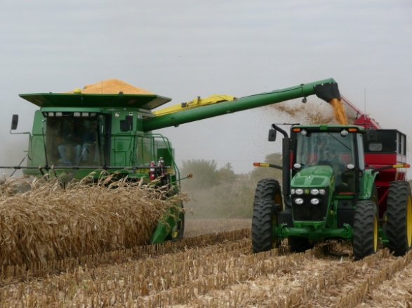
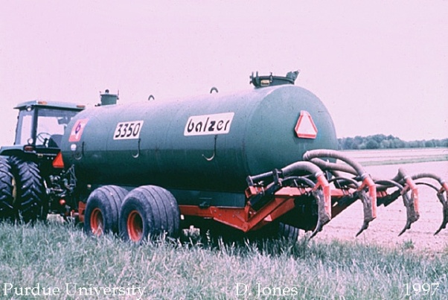

Our Program Today:
“Environmental” Contracting in Agriculture
Production
  Biofuels
  Biomass
“Services”
  Carbon sequestration
  Manure application
  Landfarming (oil and gas)
Leases
  Wind, solar, geothermal

Slide 3
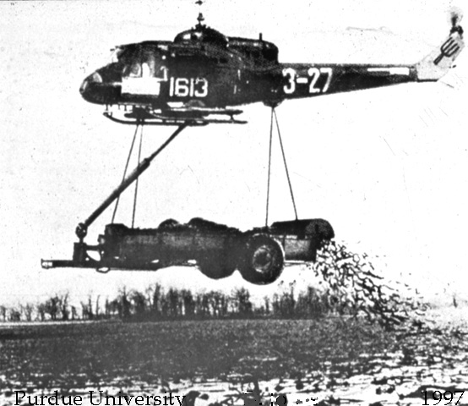
YOU MAY HAVE TO DO THINGS DIFFERENTLY THAN YOU HAVE IN THE PAST

Slide 4
The Big Picture
Tradeoff: give up a considerable amount of control / flexibility in exchange for assurances provided by contract (guaranteed market, price if specifications are met).
May lock in price, but may also introduce other risks – legal risk, risk of failing to meet contract specifications, risk of losing investment in specialized equipment if contract is terminated, etc.
Majority of risks often left on producer.
Notes:
Hamilton, “Legal Issues in Contract Production of Commodities: Issues for Farmers and their Lawyers – Part I.” Agricultural Law Update, April 1994, p. 4

Slide 5
Production risk
What are the penalties for non-compliance with contract specifications?
Are you penalized if you were not able to meet production specifications due to factors beyond your control?
Who bears the extra costs incurred to achieve specifications (like extra drying)?
What about “Acts of God” or “force majeure?”
Notes:
Checklist for Grain Production Contracts, Missouri Farm Bureau Contract Grain Production Task Force Recommendations, May, 2000, p. 4

Slide 6
Title and Risk of Loss
Who holds title to the crop?
Risk often follows title, but not always.
  Can be modified by the language of the agreement.
  Risk often gets shifted away from the contractor and towards the producer.
Ask how title will affect the other risk tools available (CCC, federal crop insurance and loans).
Notes:
Hamilton, “Legal Issues in Contract Production of Commodities: Issues for Farmers and their Lawyers – Part I.” Agricultural Law Update, April 1994, p. 5 - 6

Slide 7
Credit Risk:
Unsecured Creditors and Bankruptcy
If contracting party accepts payment at some later date than delivery, they become an “unsecured creditor.”
  “Farmers must be aware that their rights as creditors may changes, reduce, or vanish...”
  Unsecured creditors risk getting erased in bankruptcy, but secured creditors stand a better chance – must file and perfect the lien.
When a farmer receives a notice of a bankruptcy, they need to submit proof of their claim (DO NOT IGNORE THESE NOTICES).
Notes:
Jodi Lea Woodsmith, “When a Food Processor Files Bankruptcy: What Every California Grower Should Know before Contracting to Sell Crops.” 12 San Joaquin Agric. L. Rev. (2003) 103, 125-126.

Slide 8

Credit Risk:
Unsecured Creditors and Bankruptcy
Proof of claim:
  A written statement of the claim,
  A copy of the contract, and
  Proof that security interest has been perfected.
Notes:
Jodi Lea Woodsmith, “When a Food Processor Files Bankruptcy: What Every California Grower Should Know before Contracting to Sell Crops.” 12 San Joaquin Agric. L. Rev. (2003) 103, 126.

Slide 9
Preferential Transfers in Bankruptcy:
Reeling it Back In
Whatever assets a debtor transfers during the ninety-day time period prior to filing bankruptcy may be recoverable by the trustee as a preferential transfer.

Slide 10
Preferential Transfers in Bankruptcy
A payment can be recovered if it was:
Made to a creditor; AND
Made for a debt owed by the debtor before such transfer was made; AND
Made while the debtor was insolvent; AND
Made on or within 90 days before the date of the filing of the petition; AND
If the payment allowed the creditor to receive more than such creditor would receive if—
  (A) the case were a case under chapter 7 of this title (liquidation);
  (B) the transfer had not been made; and
  (C) the creditor was paid according to the bankruptcy plan.

Slide 11
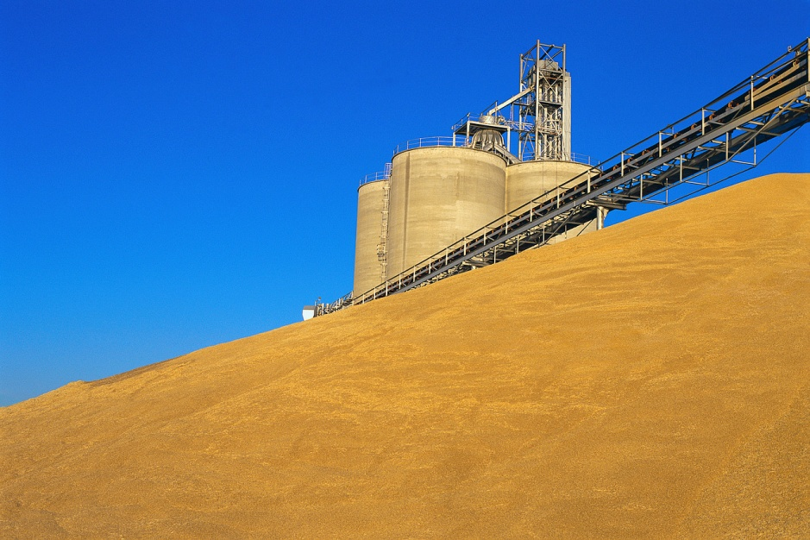
Is the Contractor a “Grain Dealer?”
Is the contractor a licensed grain dealer/warehouse?
What protections are available as a result of
that status?
Under the contract terms,
will the producer be able to take advantage of that
status?
Notes:
Checklist for Grain Production Contracts, Missouri Farm Bureau Contract Grain Production Task Force Recommendations, May, 2000, p. 5

Slide 12
Service Contracts

Slide 13
How will required production practices affect your costs and revenues?
Will any investment in new equipment be required?
  Is the length of the contract long enough to recover your investment?
  Can the contract be terminated before you recover your investment?
How is the new enterprise going to affect your overall enterprise mix and whole farm plan?
Notes:
Checklist for Grain Production Contracts, Missouri Farm Bureau Contract Grain Production Task Force Recommendations, May, 2000, p. 3

Slide 14

Time for a Background Check
Are you talking to a valid contractor?
Are you willing (and able) to give the contractor a financial statement and references?
Research and understand the background of the person or company with which you are signing the contract.
Notes:
Checklist for Grain Production Contracts, Missouri Farm Bureau Contract Grain Production Task Force Recommendations, May, 2000, p. 5

Slide 15
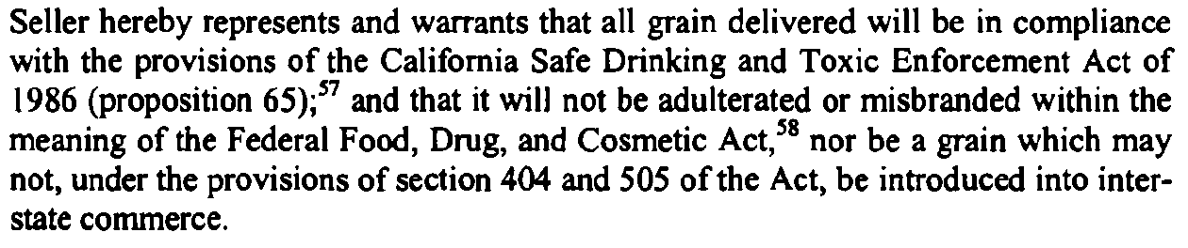
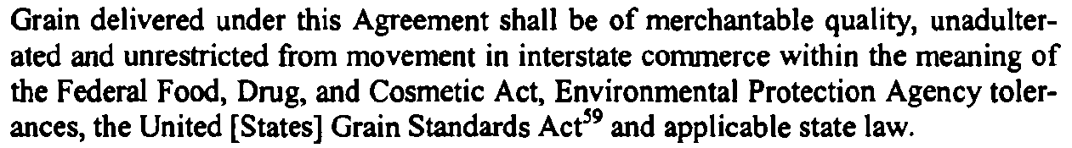
How Do I Know if I am Even Complying with the Contract?
Notes:
See also Joseph A. Miller, “Contracting in Agriculture: Potential Problems.” 8 Drake J. Agric. L. (2003) 57, 73

Slide 16
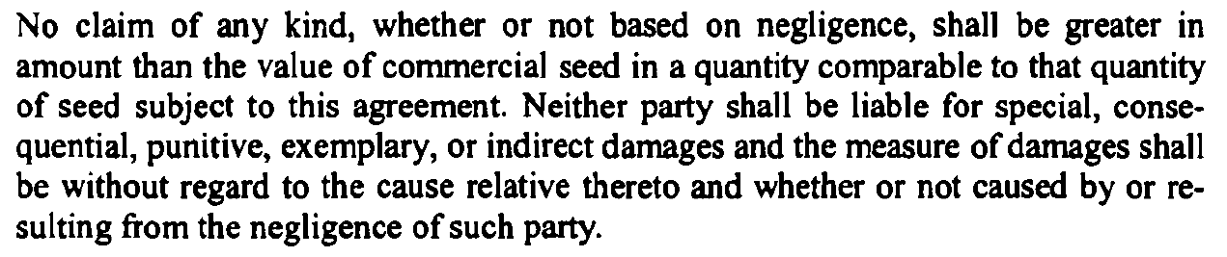
Indemnification Risks
Notes:
See also Joseph A. Miller, “Contracting in Agriculture: Potential Problems.” 8 Drake J. Agric. L. (2003) 57, 74-75

Slide 17
Indemnification and Environmental Liability
Do you have all required permits, licenses, and other government approvals?
Do you have a GOOD grasp of the applicable regulations?
Do you have best management practices above and beyond the regs?
Do you have strong indemnification language in your favor?

Slide 18
Are We Partners Here or What?
Most agreements will specify that no partnership or joint venture is to be created by virtue of the agreement.
  Partnerships can mean that liabilities of one party become the liabilities of the other.
Language regarding partnership is important, but also important is how the parties act.
  How is the producer paid?
  How are resources shared?

Slide 19
Forget Partners – Am I This Guy’s Employee?
Employees vs. Independent Contractors:
The Oklahoma Opinions
An independent contractor is one who engages to perform a certain service for another, according to his own method and manner, free from control and direction of his employer in all matters connected with the performance of the service, except as to the result thereof. Miller Constr. Co. v. Wenthold, 458 P.2d 637 (Okla. 1969).
An employer may specify and control the manner in which an employee performs the actual work itself. Bouziden v. Alfalfa Elec. Coop., Inc., 16 P.3d 450, 459 (Okla. 2000).
Contractors are paid based largely on performance, rather than receiving a wage or salary, which is indicative of an employment relationship, Mistletoe Express Serv., Inc. v. Culp, 353 P.2d 9, 12 (Okla. 1959).
Courts have held that provision of one's own equipment and the right to engage employees are factors which militate in favor of finding that the person in question is an independent contractor. Cook Constr. Co. v. Longcrier, 405 P.2d 165, 169 (Okla. 1965) (Williams, J., dissenting).
Notes:
2001 OK AG 17
See also Joseph A. Miller, “Contracting in Agriculture: Potential Problems.” 8 Drake J. Agric. L. (2003) 57, 66-67

Slide 20
Leases
(Stay tuned for the next session)

Slide 21
General Considerations for all contracts

Slide 22

Who needs to be at the table?
Your attorney
Your accountant or other financial professional
FSA
Crop insurance professionals
Are you prevented from discussing the contract with others?
  Other producers?
  Landlords?
  Lenders?
Notes:
Checklist for Grain Production Contracts, Missouri Farm Bureau Contract Grain Production Task Force Recommendations, May, 2000, p. 3, 5

Slide 23
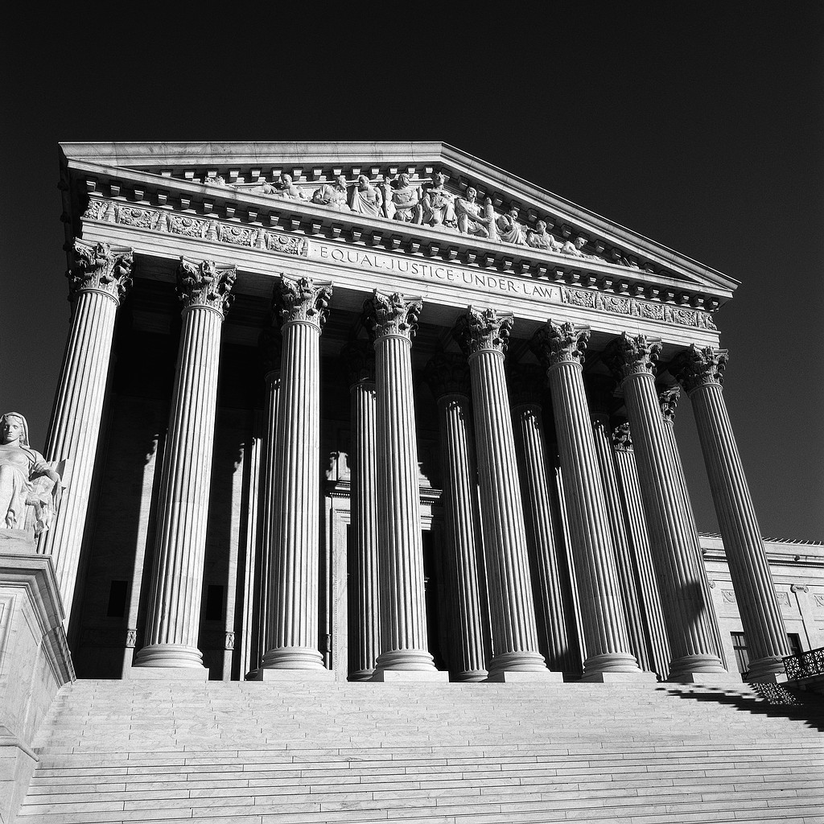
Arbitration May Not Be
All its Cracked Up to Be...
Parties may have to pay for the arbitration panel (and most contracts specify “loser pays”).
The rules of evidence may be different.
Heck, a lot of the rules may be different.
Watch for “choice of law” clauses.
  Most state’s choice of law rules would state that the
  home court of the producer is where the case should
  be tried.
If you have a disagreement with the other party do NOT cash the check. Cashing the check may be deemed by the court as settlement of the dispute.
Notes:
See also Joseph A. Miller, “Contracting in Agriculture: Potential Problems.” 8 Drake J. Agric. L. (2003) 57, 79

Slide 24
Other Considerations
Your questions may be satisfactorily answered before you sign a contract but not afterward. Understand all aspects of the contract before signing.
Don’t sign a contract you do not like hoping to negotiate better terms later.
Document everything you do.
Notes:
Checklist for Grain Production Contracts, Missouri Farm Bureau Contract Grain Production Task Force Recommendations, May, 2000, p. 2

Slide 25



