Slide 1
FarmAnswers.org
The Largest Source of Information for
Beginning Farmers

Slide 2
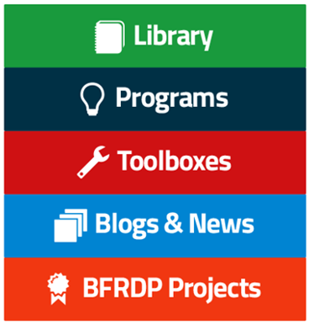
FarmAnswers.org
Find the information and programs you need

